Slide 1

CWG Animal Health & Welfare Research
Plenary online meeting
15 May, 2025

Slide 2
Aim of the meeting
To consolidate the European network with Funding Organizations, experts and private partners with a major interest in AH&W.
Reach out to DG-AGRI, EFSA and WOAH, incl. SANTE, MARE and RTD, RefreSCAR.
  Invite SCAR Working Groups SAP, SCARfish, FoodSystems.
Encourage the AH&W cooperation within countries.
Please mute your microphone!
The meeting will be recorded for preparing the minutes, not for distribution.
You can use the chat for questions, which will be answered in the minutes.

Slide 3
Agenda
Welcome and introduction.
Follow up of the plenary meeting, 10 December 2024 in Rome.
Feedback from Animal Welfare and Strategy & Foresight Unit subgroups.
Country consultation on research priorities and challenges.
Collaboration with RefreSCAR.
Update on STAR-IDAZ.
Update on ICRAD ERA-NET, Paris 29 April meeting.
European Partnership AH&W: provisional research results.
Update on DISCONTOOLS.
Intro to CWG Food Systems.
AOB: next plenary meeting.

Slide 4
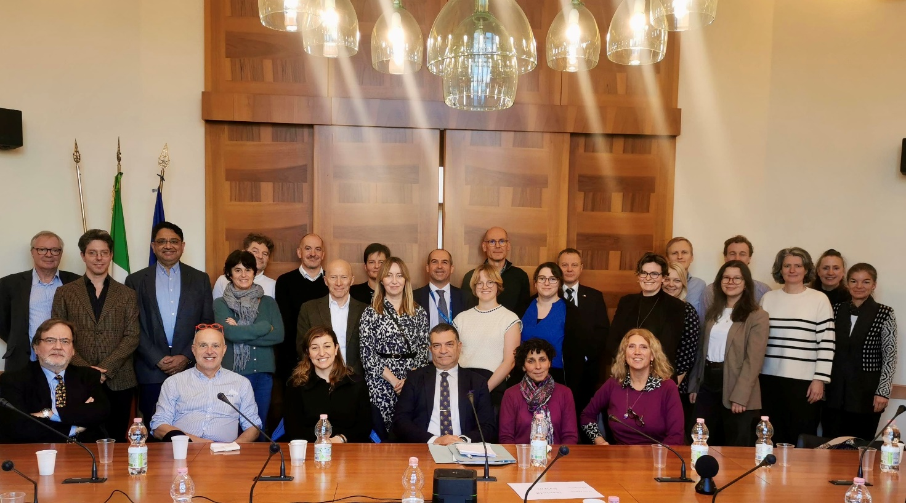
Follow up of 10 December 2024 plenary
In-person meeting in Rome – very well
organised!
Country research report on Highly-Pathogenic
Avian Influenza.
  All to inform Hein if the HPAI report was distributed and how it was received. no comments received yet
  Hein to discuss with Maddy the alignment of the CWG and STAR-IDAZ surveys. OK
  When the AH&W research survey is launched in 2025, all to contribute to its completion in order to have as complete a picture as possible of the interests of partner countries. Thank you!
  Hein to inform CWG members when the RefreSCAR report on the various SCAR Working Groups is published. not published yet

Slide 5
Rome meeting
Research topics to discuss with RefreSCAR.
  Hein to contact RefreSCAR and propose a planning for developing the topics, as well as the possible types of support.
Update on STAR-IDAZ and the CWG website.
  All to contact the STAR-IDAZ Secretariat through Gareth Dicks to help testing the new CWG website. done, all can sign up
  STAR-IDAZ staff to collect documents from the EMIDA website. All to share relevant older CWG documents with STAR-IDAZ, Gareth Dicks, identifying whether it should be publicly available or not. tbd …
Update on ICRAD ERA-NET
  Anyone interested in helping to support the aims of the Showcase meeting should contact Thom Erritt.

Slide 6
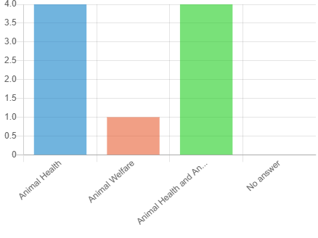
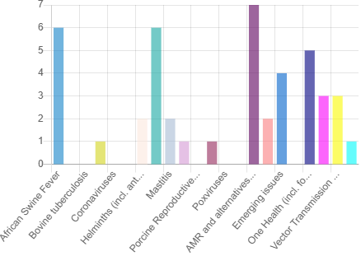
Research priorities and challenges
Online country consultation from 4 March.
  12 May: 10 full responses.
  Main expertise: 4 AH, 1 AW, 4 both.
  STAR-IDAZ priority topics, both diseases and infections, as well
  as cross-cutting issues: highest priority for your organisation.
    AMR
    ASF, Helmintics
    One Health
    Emerging issues
    XX, Vectorborne diseases
  Please complete if not yet done!
The FP10 questionnaire in Nov-Dec 2024
also asking for priorities.
  See SCAR > AH&W CWG website for this FP10 report.

Slide 7
Any Other Business
Next plenary meeting in-person in Krakow / Balice, Poland! https://iz.edu.pl/en
  Thanks to Anna Orchel-Szeląg and Dorota Godyń!
  See next slides.
  Somewhere in mid-October to mid-November; doodle to be sent out.

Slide 8
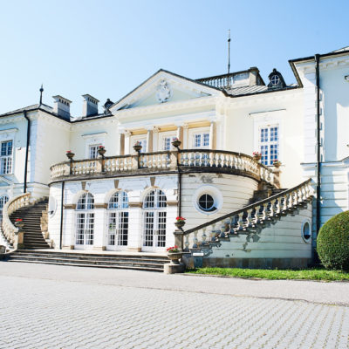
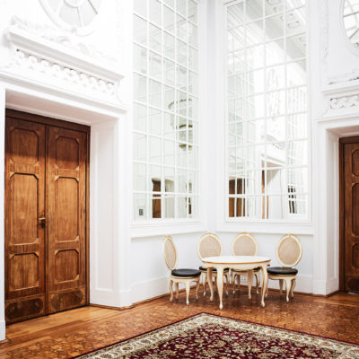
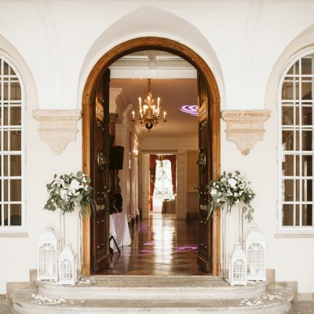
Meeting in Krakow (Balice)
https://iz.edu.pl/en/

Slide 9
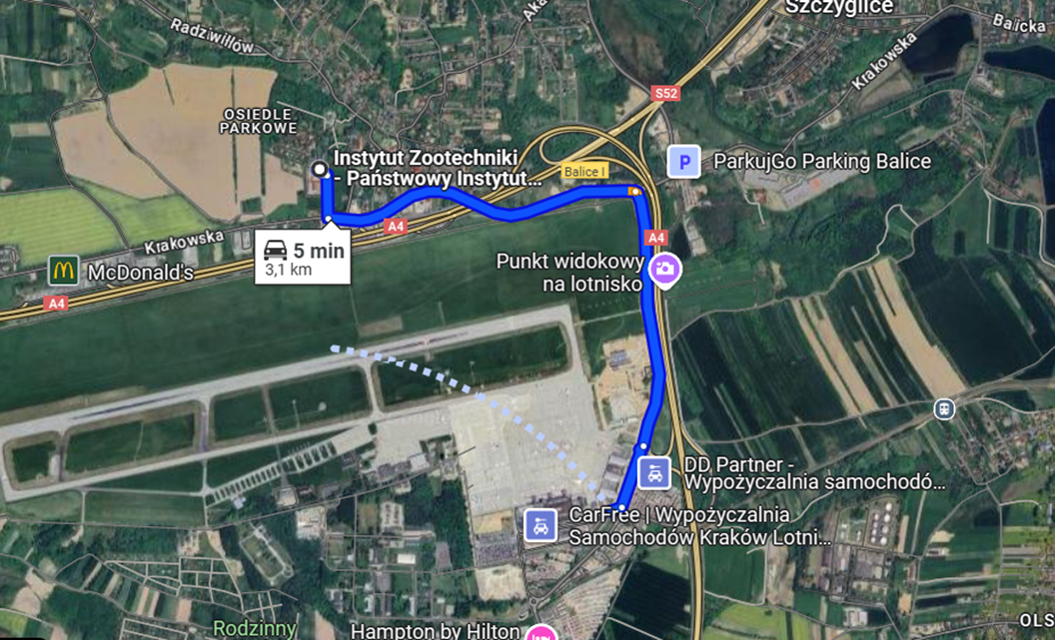
The palace is located close to the airport Krakow/Balice
https://krakowairport.pl/en/
https://krakowairport.pl/en/passenger/transport-en/directions/from-to-krakow-airport/krakow-airport-taxi-service-en/

Slide 10
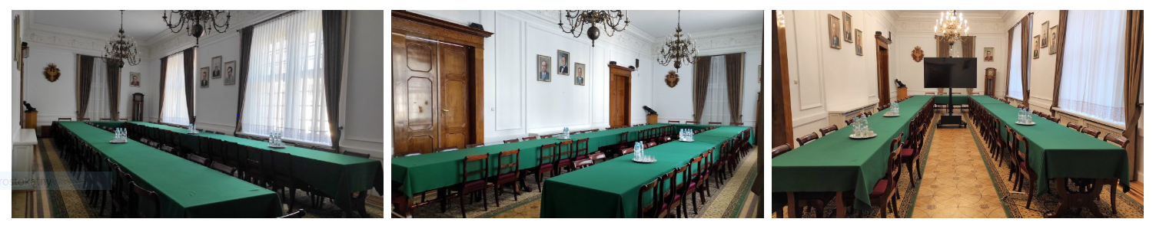
Meeting Rooms (in the Palace in Balice)
located in the Radziwiłł Palace,
60 seats,
arrangement: horseshoe
equipment: sound system, projector, screen, 75″ TV

Slide 11
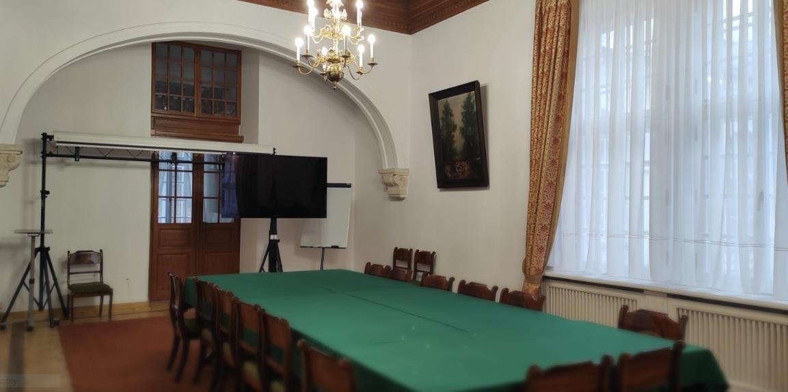
Meeting Rooms (in the Palace in Balice)
located in the Radziwiłł Palace,
15 seats,
equipment: projector, screen, 75″ TV

Slide 12
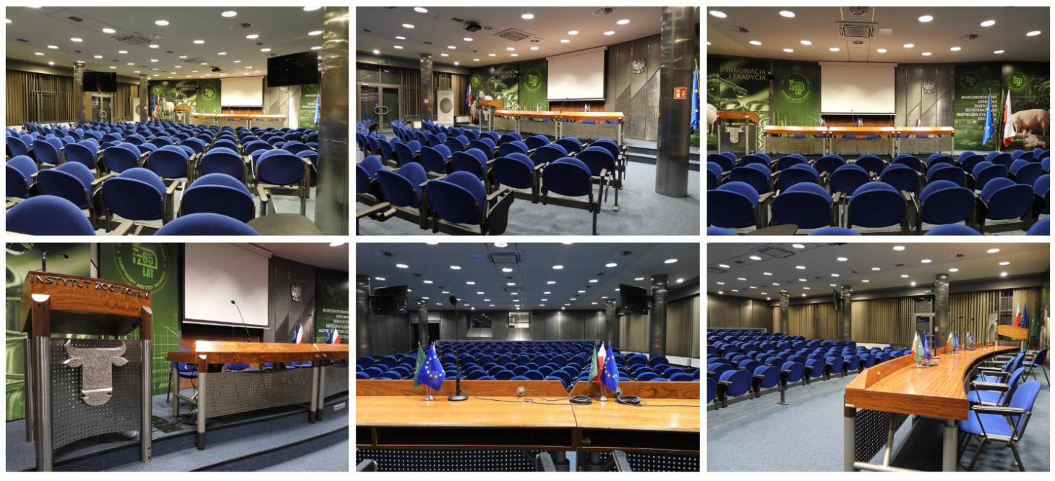
Meeting Room (Office Building)
5 min walking distance from the Palace

Slide 13
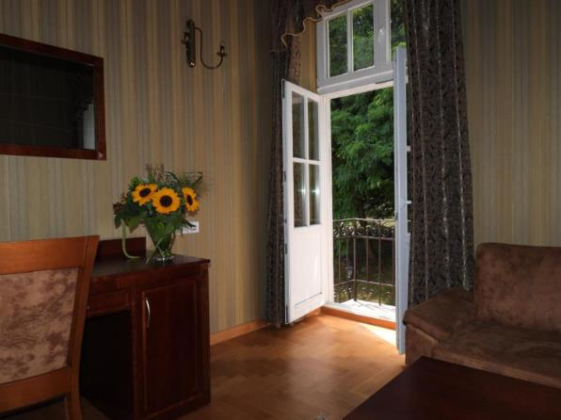
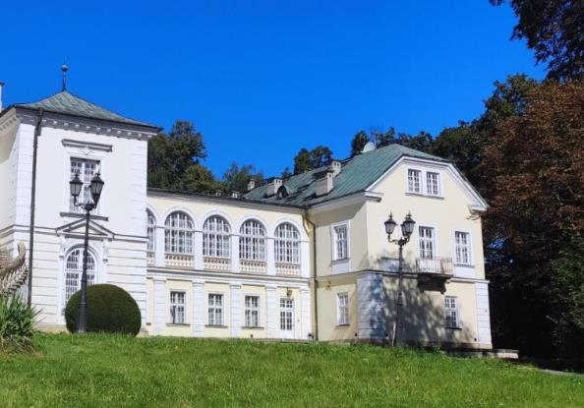
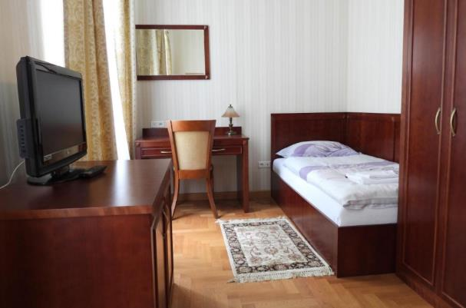
Hotel in the Palace
https://palacbalice.com/
If you decide on a hotel in Krakow, it would be a good idea for it to be located quite close to Galeria Krakowska (which is close to the main railway stationn- Krakow Główny).

Slide 14
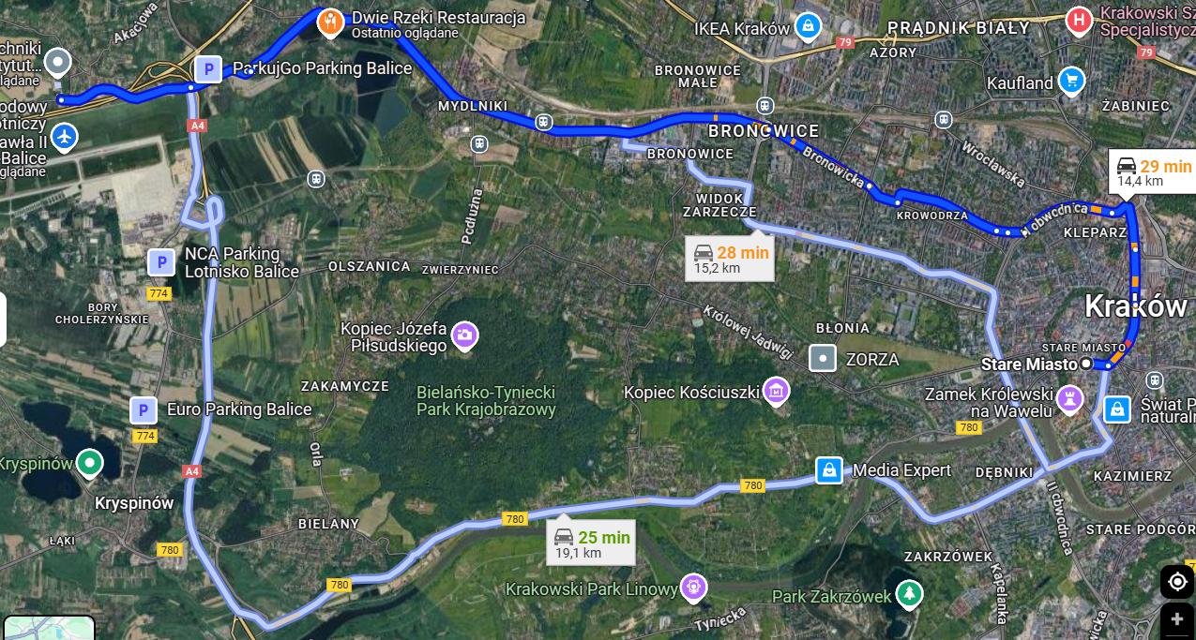
How to get to the Krakow centre?

Slide 15
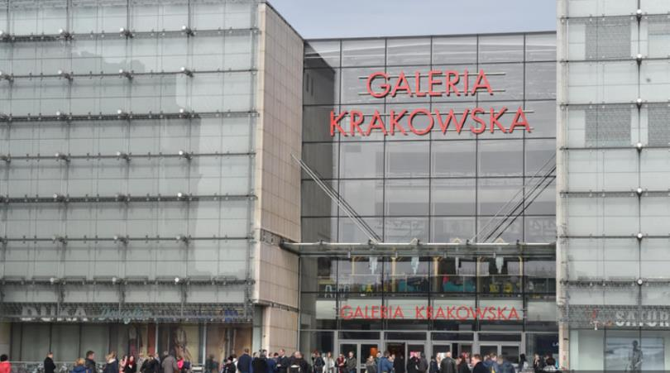
Train (Fastest and Most Convenient)
You have to get from Balice Palace to
the Airport
Route: Kraków Airport → Kraków Główny
Duration: ~17-20 minutes
Cost: ~17 PLN (~4 EUR)
Details:
  Take the train directly from the
  airport terminal.
  Trains run roughly every 30 minutes.
  Galeria Krakowska is directly connected to the Kraków Główny train station — just walk into the mall from the station.
https://krakowairport.pl/en/passenger/transport-en/directions/from-to-krakow-airport/train-en

Slide 16
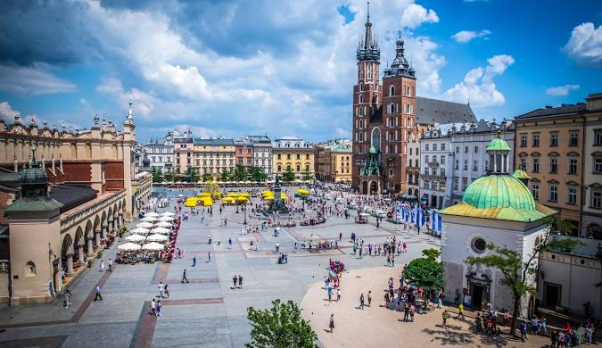
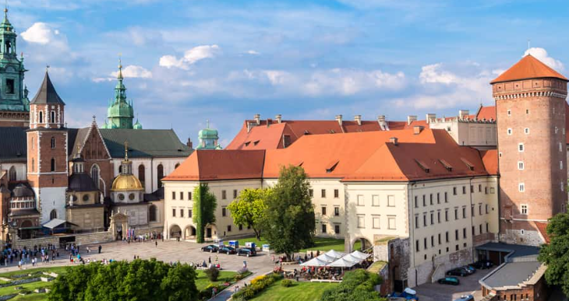
I Krakow
https://visitkrakow.com/

Slide 17
Any Other Business
Any Other Business?

