Slide 1



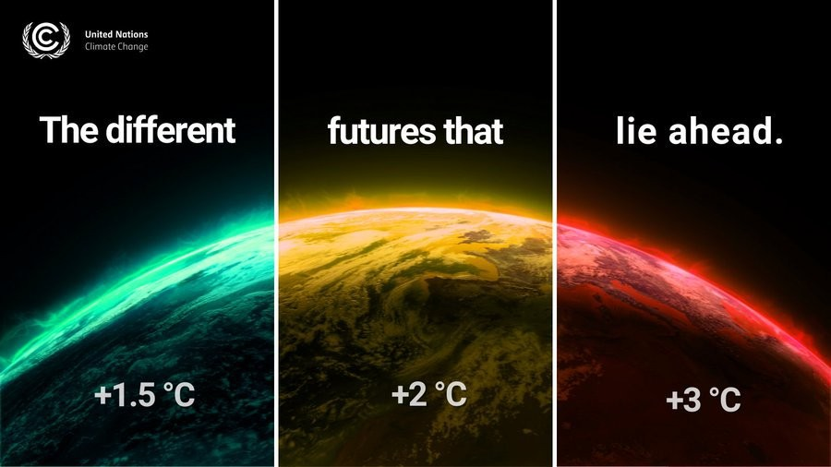
Climate Change: Impacts on Animal Health and Welfare
A joint CWG AHW and FishSCAR Activity
Notes:
The abstract pattern can be removed or repositioned if required. Be careful to ‘Send to Back’ so that it does not obscure any important information.

Slide 2
Working with RefreSCAR
Aim
  To bring the European Animal (including aquaculture) Health and Welfare research and policy communities together through a series of workshops to discuss research and policy needs and opportunities to address impacts of climate change on animal health and welfare in an integrated approach
  Objectives
    To identify the research and innovation gaps and needs to understand, adapt and mitigate the effects of climate change on Animal Health and Welfare. Also, to understand and appreciate regional needs and possible synergies across Europe
Outcomes
  White Paper or Report detailing the climate related research and innovation needs in the animal health and welfare communities in Europe to be written by the RefreSCAR team
  Relevant information to feed into a future funding call for the Animal Health and Welfare Partnership or relevant evidence to feed into updating the Strategic Research and Innovation (SRIA) of the EU Partnership AH&W .
  Uptake of R&I gaps by country Funding Organisations that are member of the CWG AH&W.

Slide 3
Process
Survey
4 online regional meetings
A report
The final in-person workshop bringing all four online groups together
to identify the most important and urgent research and innovation gaps and challenges within specific regions of Europe
is to identify the most important and urgent research and innovation gaps and challenges for Europe as a whole
The aim of this survey is to seek views of the CWG AH&W members on impact of climate change on animal health and welfare and the country specific research and innovation gaps and needs. In doing so, members will be expected to consult with their national experts . This survey will form the basis of the workshop.
Detailing research and innovation needs to understand, adapt and mitigate the effects of climate change on Animal Health and Welfare

