Slide 1
Themes for RefreSCAR ToR:
Risk communication
Marina Bagni, Gyula Kasza, Hermann Schobesberger, Barbara Tiozzo Pezzoli, Andras Vig
Meeting of the SCAR CWG Strategy and Foresight Unit WG8 Risk communications | May 13th 2025

Slide 2
Overview
Why?
There is a growing need to understand the facilitating and hindering factors in risk communication to ensure effective responses to future emergencies and promote a well-informed, participatory public discourse around animal welfare and health management.
How
RefreSCAR support: from Portfolio analysis to Study, due to differences in both content and outputs
Portfolio analysis involves the assessment of projects only (initially 30 and then 10 in depth) and looks at research gaps and needs | description of research gaps and needs in the topic area
Study involves the analysis of knowledge, documents and papers | research gaps and needs in the topic area, recommendations to policy makers and risk managers

Slide 3
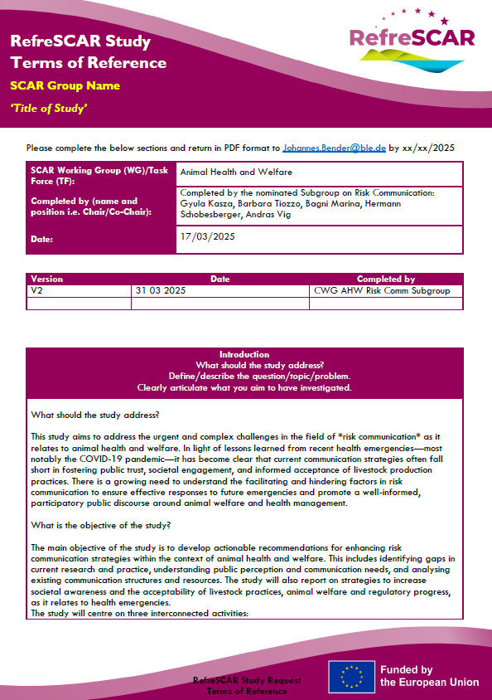
Overview
Documents
ToR Study template
Annexes
  Gap Analysis criteria
  Reference list
  Criteria for experts’ profile to be involved in the gap analysis
Aims
To develop actionable recommendations for enhancing risk communication strategies within the context of animal health and welfare
To identify gaps in current research and practice, understanding public perception and communication needs
To get strategies to increase societal awareness and the acceptability of livestock practices, animal welfare and regulatory progress.

Slide 4
Methodology
Preparatory work: criteria for gap analysis, reference list (living document), criteria for selection of experts | SCAR CWG SFU RC
Gap Analysis
Literature review (projects, papers, guidelines, etc):
executed by RefreSCAR selected experts and supported by a guideline of criteria and a reference list | RefreSCAR + SCAR CWG SFU RC
Thematic priorities identification
Thematic priorities identification:
e.g. identification of urgent research needs, recommendations, … | RefreSCAR + SCAR CWG SFU RC
Participatory workshop
Participatory workshop:
30-60 stakeholders and experts (selected and balanced representatives) working together | RefreSCAR + SCAR CWG SFU RC

Slide 5
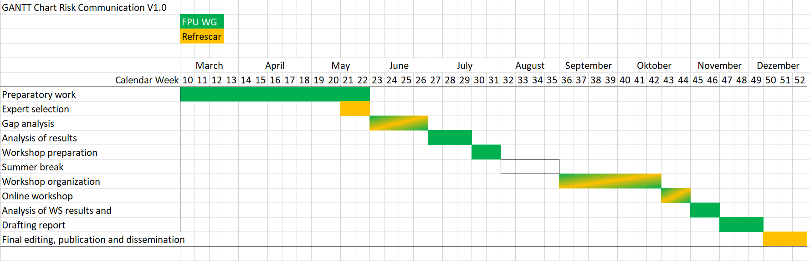
Timing
The timeline might slip, depending on when the activities (gap analysis) officially start.

Slide 6
Next steps
Requested templates have been appropriately filled in
  ToR template + some annexes to serve as preparatory work: gap analysis criteria | reference list | experts’ profile criteria
RefreSCAR will shortly contact their Knowledge Provider to seek expression of interest
SCAR CWG SFU WG8 RC will continue the preparatory activities, supporting RefreSCAR

Slide 7
Thank you for your attention!

