Slide 1
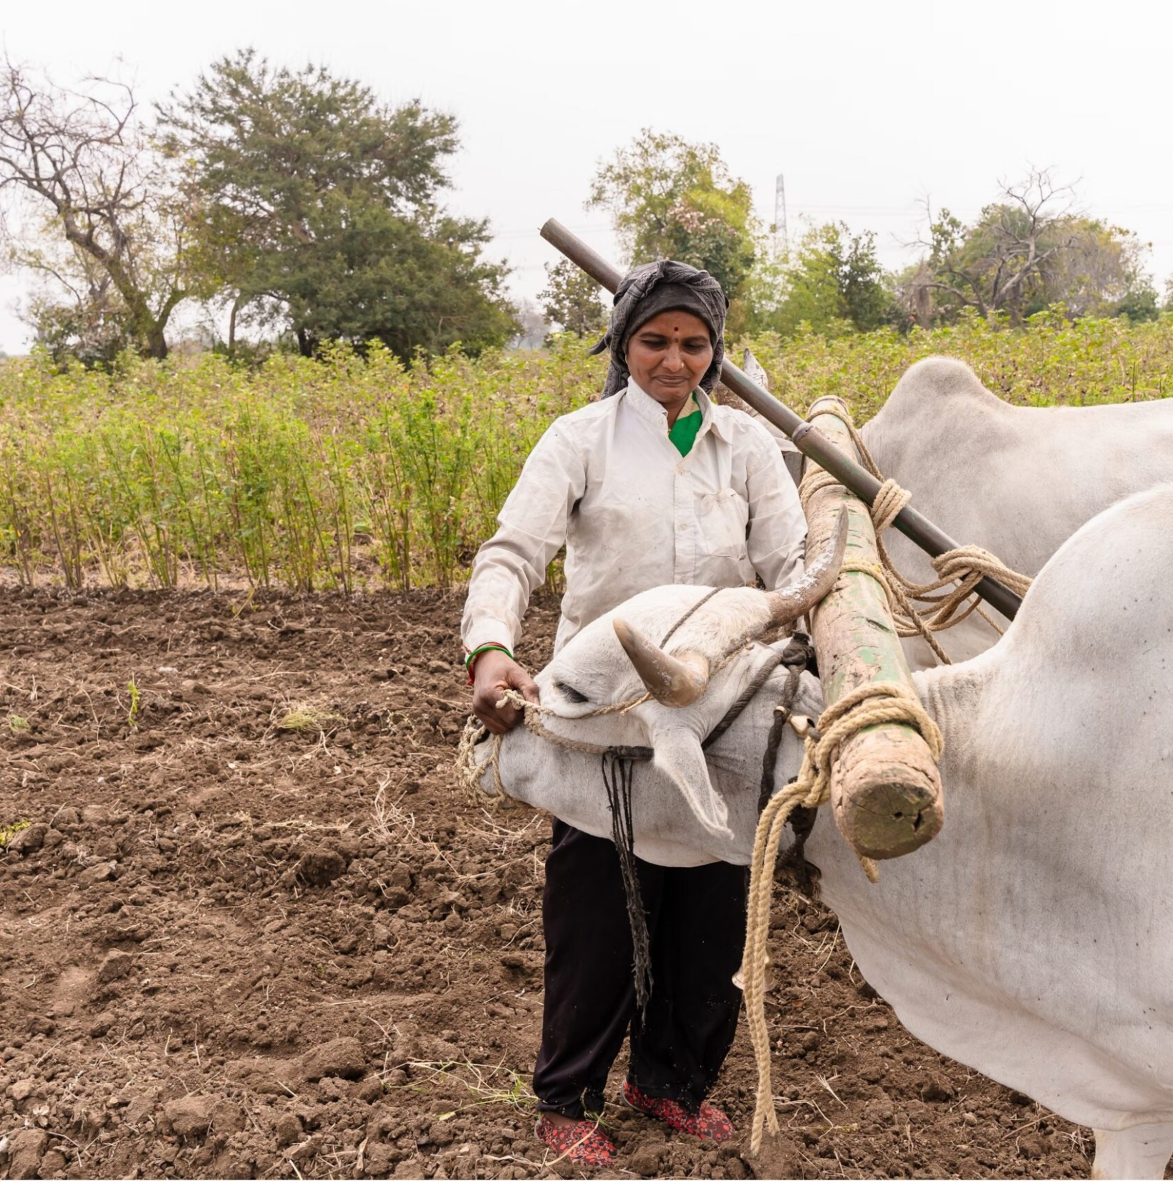

STAR IDAZ International Research Consortium on Animal Health: Update
Collaborative Working Group on Animal Health and Welfare
Thursday 15th May 2025

Slide 2
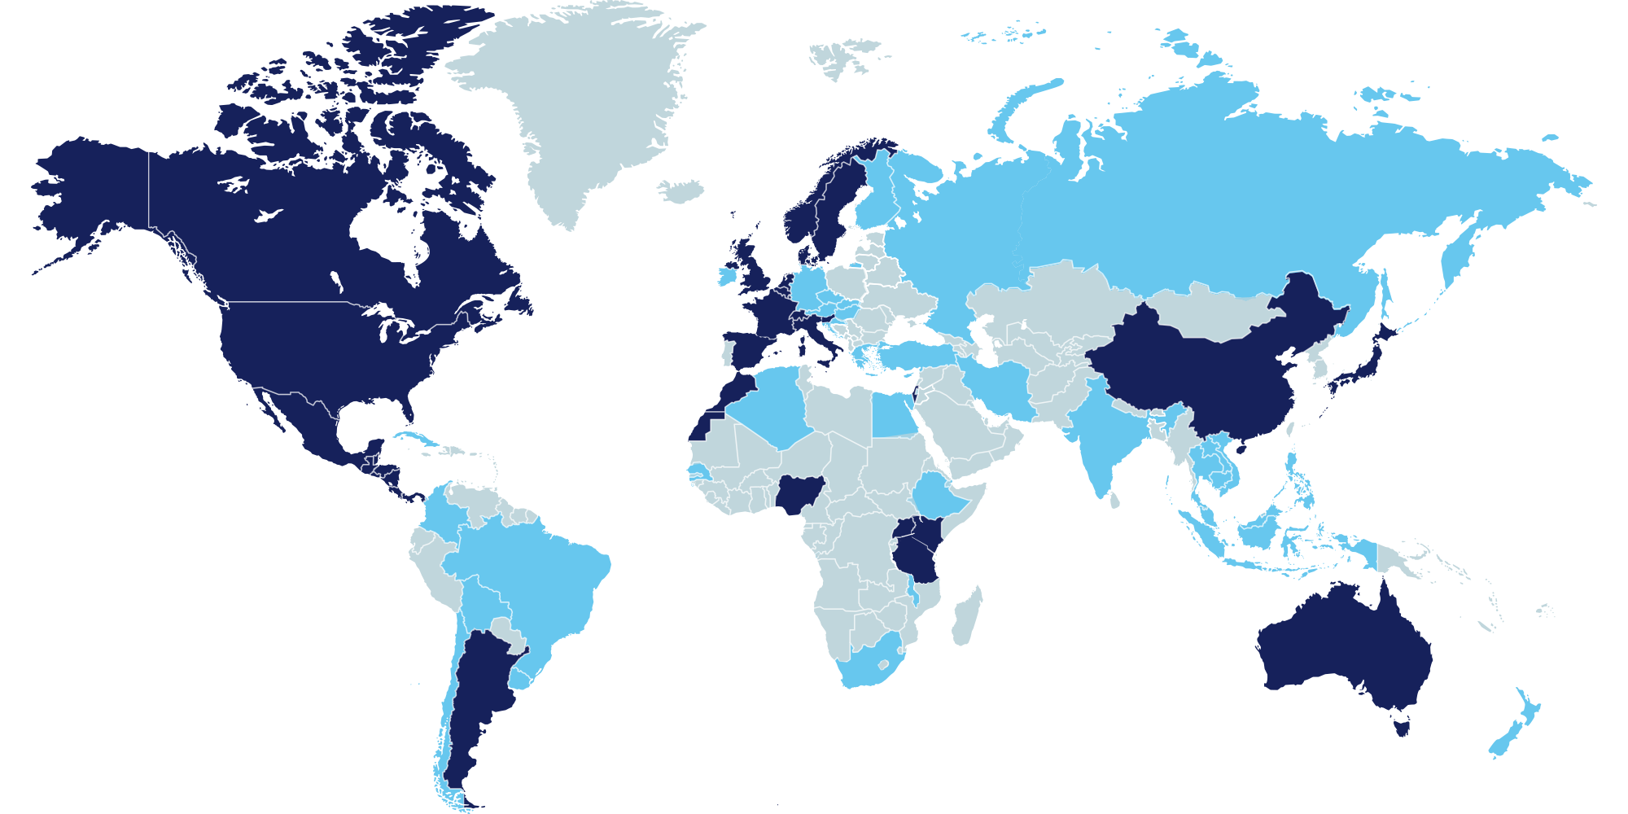






























STAR IDAZ
Global Strategic Alliances for the Coordination of Research on the Major Infectious Diseases of Animals and Zoonoses
36
23
+$2.5B
4
55+
SCAN ME
PARTNER ORGANISATIONS
COUNTRIES
RESEARCH INVESTMENT
REGIONAL NETWORKS
ASSOCIATED COUNTRIES
Join Now

Slide 3



Minimum level of US$ 10 million* investment in research on shared priorities over a 5-year period required for IRC partnership
Agreed to delivery targets
Agreed to coordinate/align funding to deliver targets
(members' own funding procedures, unless agreed otherwise; governance document & policy guidelines)
*Group funding commitment possible
Agreed to share research information
(as much as necessary, without jeopardising IPR)

Slide 4
Objectives and deliverables
The overall objective of STAR-IDAZ IRC is to coordinate research at international level to contribute to delivery of new and improved animal health strategies
Deliverables include:
Candidate vaccines
Diagnostics
Therapeutics
Other animal health products and procedures
Key scientific information/tools to support risk analysis and disease control
Basic research
Translational research
Applied research
Technology transfer
Countermeasures
Diagnostics
Vaccines
Therapeutics
Scientific information
Pathogenesis
Transmission
Epidemiology
Modelling
Biosecurity

Slide 5






Research prioritisation and coordination
Avoid duplication:
Maximize resources by reducing redundant efforts
Enhance impact:
Align policy priorities and global health research priorities
Improve data sharing:
Encourage sharing of information and better decision making
Optimise funding:
Support strategic investment in critical areas to drive impactful change
Foster collaboration
Accelerate faster discoveries

Slide 6
IRC Executive Committee Partners (36)
Africa & Middle East
Israel - Kimron Veterinary Institute
Kenya - Kenya Agricultural & Livestock Research Organisation (KALRO)
Morocco - Office National for the Sanitary Safety of Food Products (ONSSA)
Nigeria - Nigerian Animal Health Research Network led by National Veterinary Research Institute Vom
Tanzania - Tanzania Veterinary Laboratory Agency (TVLA)
Uganda - National Agricultural Research Organisation (NARO)
Europe
Belgium – Regional Belgium Consortium (STAR IDAZ.be)
Denmark - Danish National Veterinary Institute (DTU Vet)
European Commission
France - National Institute of Agricultural Research (INRAE)
France – National Agency for Health, Food, Environmental and Occupational Safety (ANSES)
Italy - Ministry of Health
Norway - Norwegian Veterinary Institute (NVI)
Spain - National Institute for Agricultural and Food Research and Technology (INIA)
Sweden - Swedish Veterinary Agency (SVA)
Switzerland - Regional Consortium Switzerland
The Netherlands - Ministry of Agriculture, Fisheries, Food Security and Nature (LVVV)|
UK - Biotechnology and Biological Science Research Council (BBSRC)
UK - Department for the Environment, Food and Rural Affairs (Defra)
Americas
Argentina - Ministry of Science, Technology and Productive Innovation (MINCYT)
Argentina - National Institute of Agriculture Technology (INTA)
Canada - Canadian Food Inspection Agency (CFIA), Canada
Canada - International Development Research Centre (IDRC)
Mexico - National Advisory Council on Animal Health (CONASA) and the National, Mexico Autonomous University of Mexico (UNAM), Faculty of Veterinary Medicine and Zootechnics (FVMZ), Mexico
USA - Agriculture Research Services, United States Department of Agriculture (USDA ARS)
USA - National Institute of Food and Agriculture, United States Department of Agriculture (USDA NIFA)
International organisations & others
World Organisation for Animal Health (WOAH)
International Livestock Research Institute (ILRI)
Gates Foundation (BMGF)
Zoetis
HealthforAnimals
Diagnostics for Animals (Veterinary Diagnostics Manufacturers) (formerly EMVD)
Global Alliance for Livestock Veterinary Medicines (GALVmed)
Asia & Australasia
Australia – Australian Centre for Disease Preparedness (ACDP), CSIRO
China - Lanzhou Veterinary Research Institute, Chinese Academy of Agricultural Sciences (LVRI, CAAS)
Japan - National Institute of Animal Health, National Agriculture and Food Research Organisation (NIAH, NARO)

Slide 7
Working Group updates

Slide 8

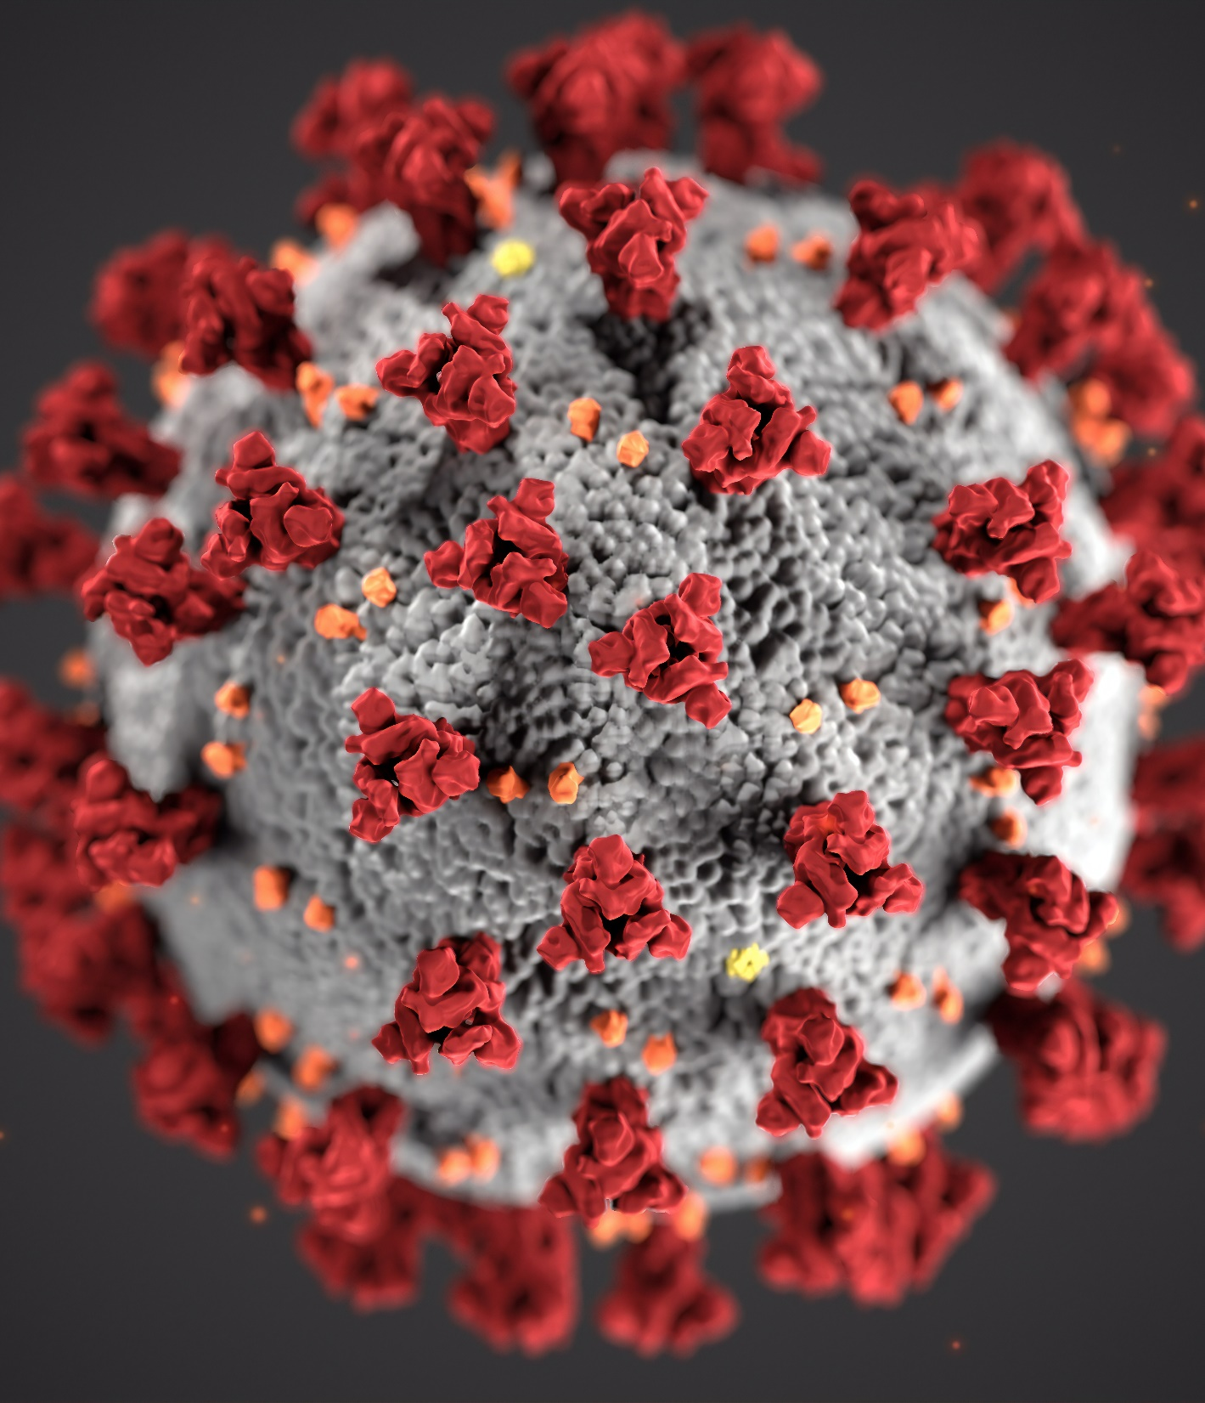

Coronaviruses
Recent publication of three research roadmaps, covering vaccine development, control strategies, and diagnostic tests
The roadmaps developed through a series of workshops attended by 60 global experts, across 21 countries
The interactive roadmaps can be accessed on the STAR IDAZ website

Slide 9
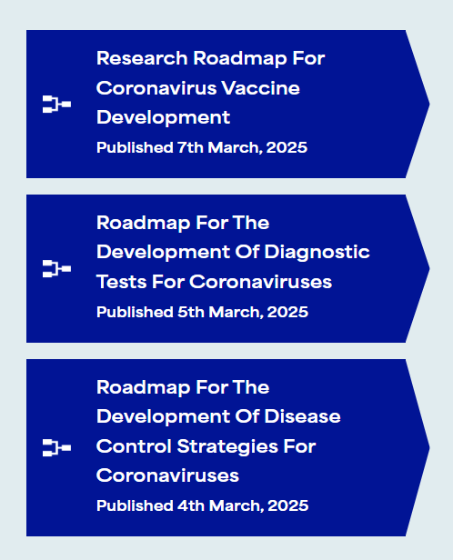
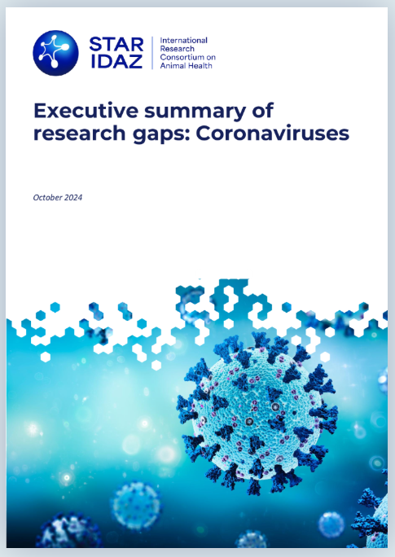



Coronaviruses
SCAN ME
SCAN ME
Valeria Mariano
SCAN ME

Slide 10


Aquaculture
STAR IDAZ and WOAH worked together to identify priority research area for aquaculture (act.4.5 WOAH Aquatic Animal Health Strategy)
In January 2025, a global survey was conducted inviting international aquaculture experts to identify research priorities for aquatic animal health
In February 2025, a successful aquaculture research workshop was held in Paris. Global experts tackled key challenges in finfish health

Slide 11

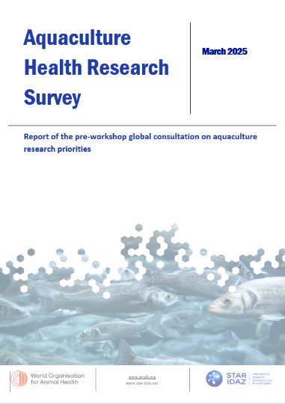
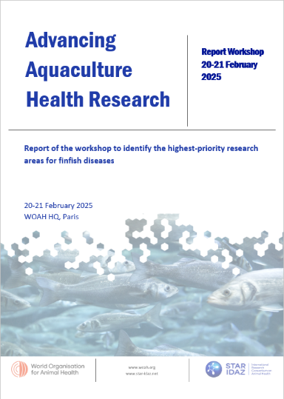
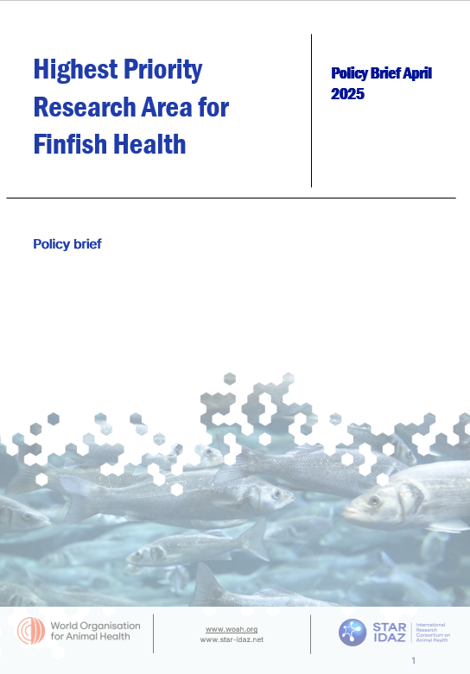
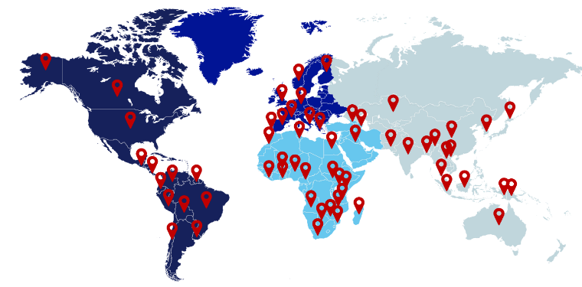
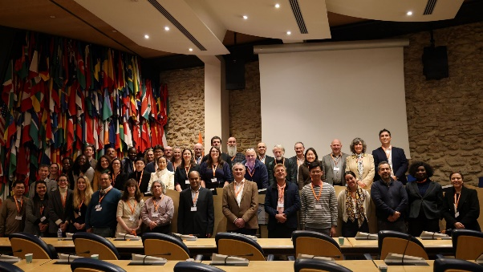
Aquaculture
SCAN ME
Online survey
Gap analysis workshop
Executive summary
January 2025
February 2025
April 2025

Slide 12
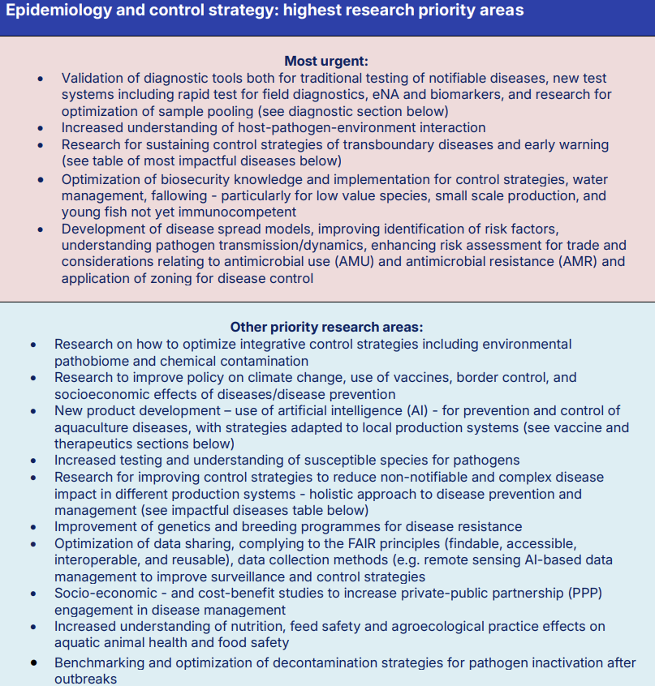
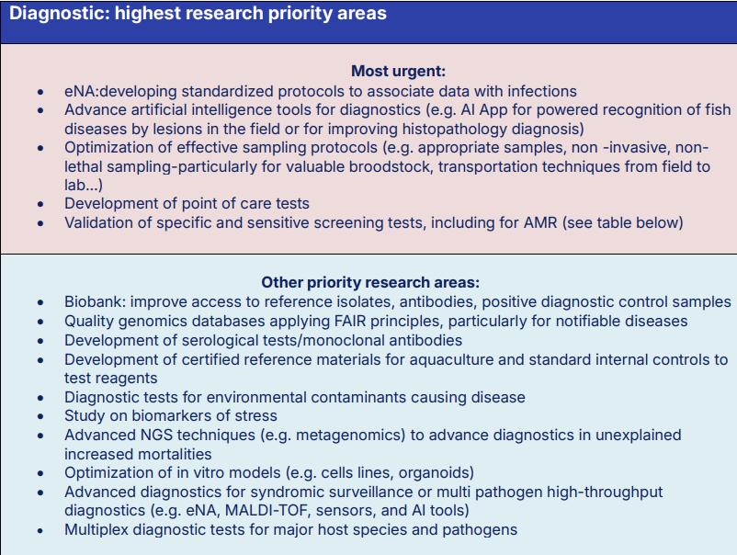
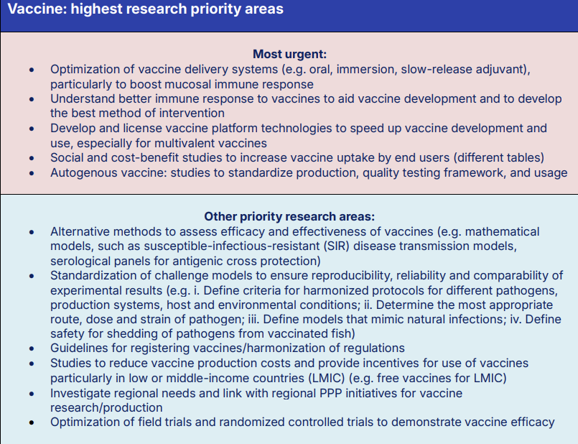
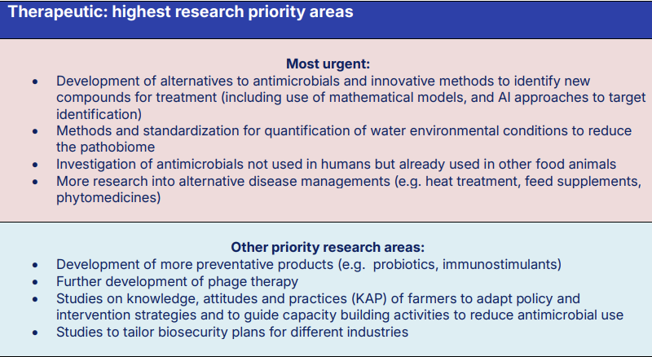
Aquaculture

Slide 13
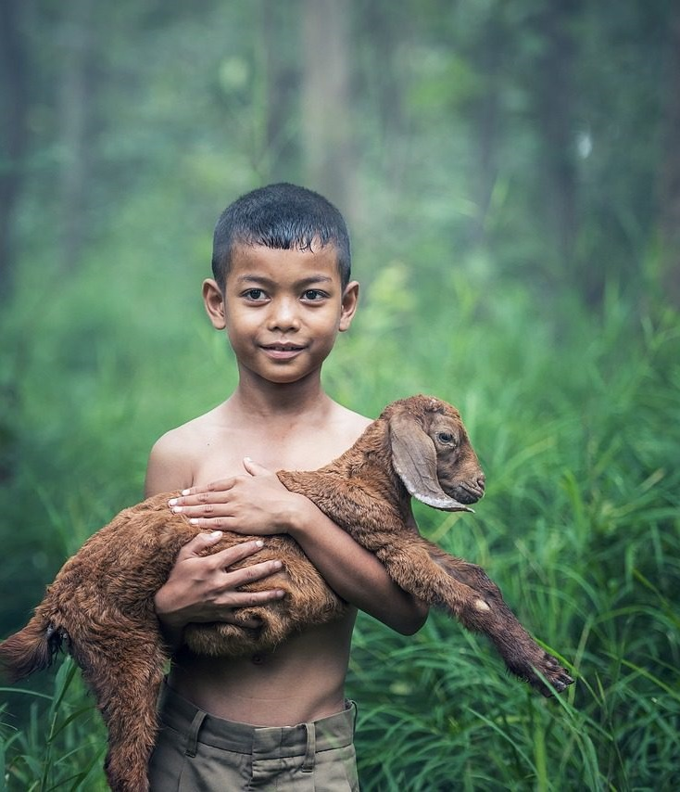
One Health
One Health funding workshop: 12-13 March 2025, Nairobi, Kenya
Attended by diverse mix of researchers, programme owners, funders, resource partners and all Quadripartite organisations
Overall aim: To influence animal health research funders and programme owners to improve funding mechanisms for research that embeds One Health, integrated, holistic approaches
Identified main challenges to funding research with a One Health lens
Co-developed and agreed practical solutions to address those challenges

Slide 14

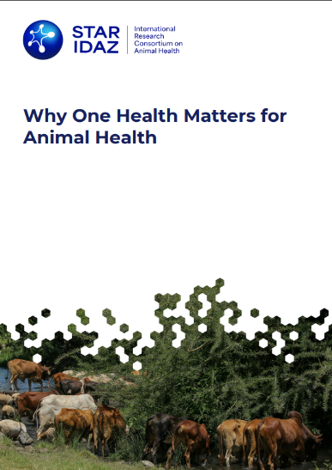
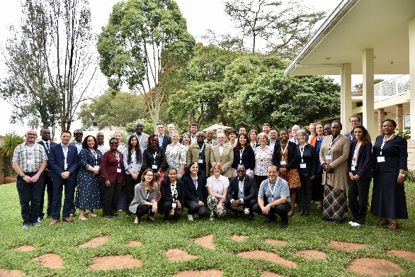
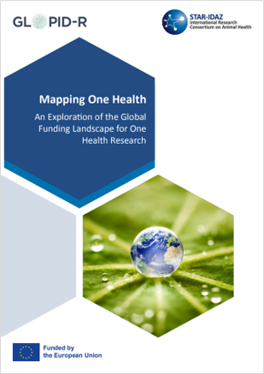
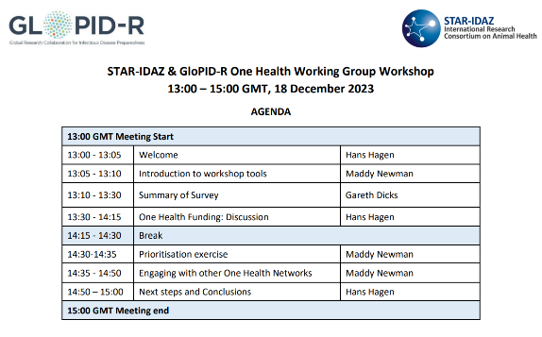
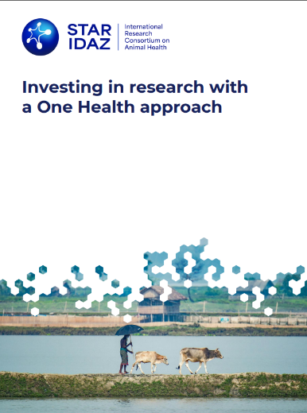
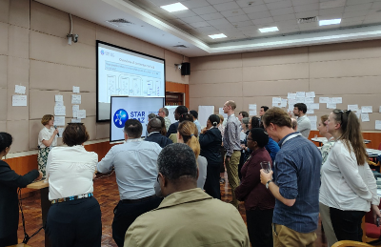
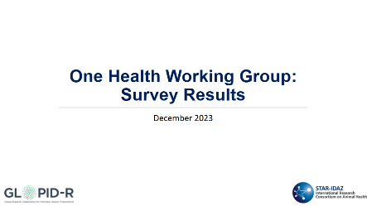
One Health
SCAN ME
To be published in coming week…
Gap analysis survey workshop
Mapping One Health report
Funding workshop
Additional reports
Workshop report & recommendations
December 2023
August 2024
March 2025
May 2025
Notes:
This report explores the broader One Health funding landscape, identifying opportunities, challenges, and solutions for impactful, cross-sectoral collaboration.

Slide 15
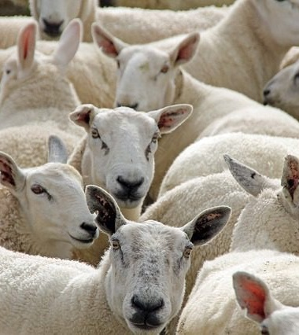

Brucellosis
Development of candidate vaccine roadmap published in 2018
Next steps to update the roadmap:
Survey: To understand research gaps related to vaccine development
Discontools Report: Key insights and updates
Workshop: To identify critical research gaps to update the brucellosis research vaccine roadmap
Date: 3 November 2025
Location:

Slide 16

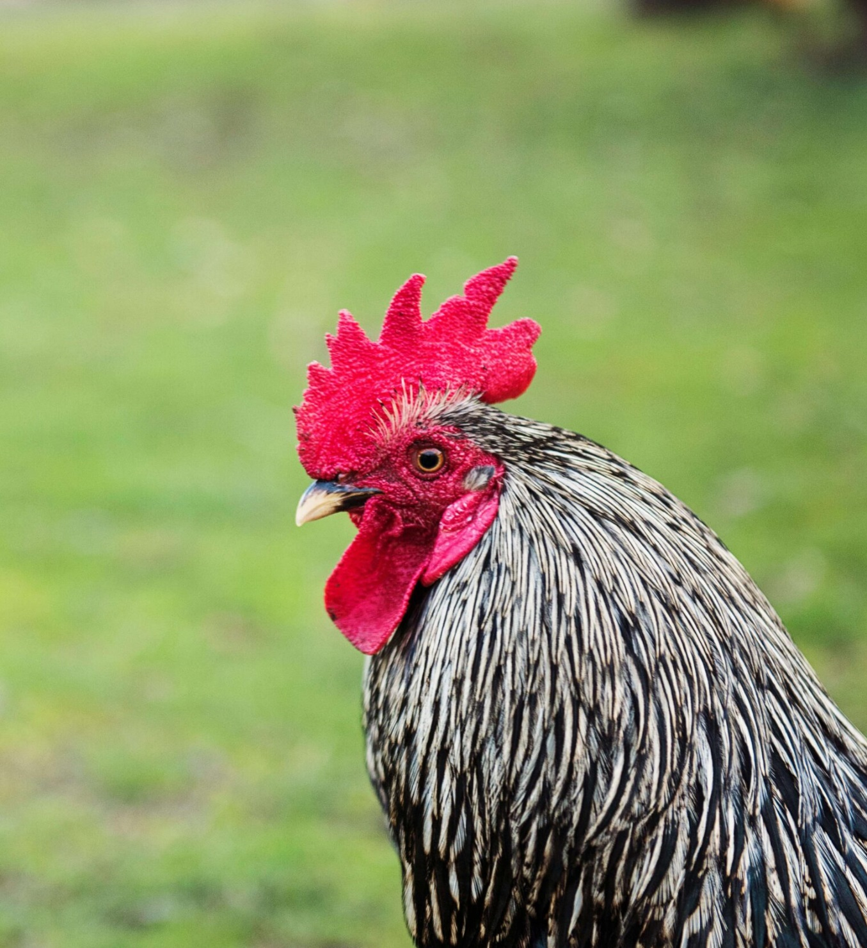
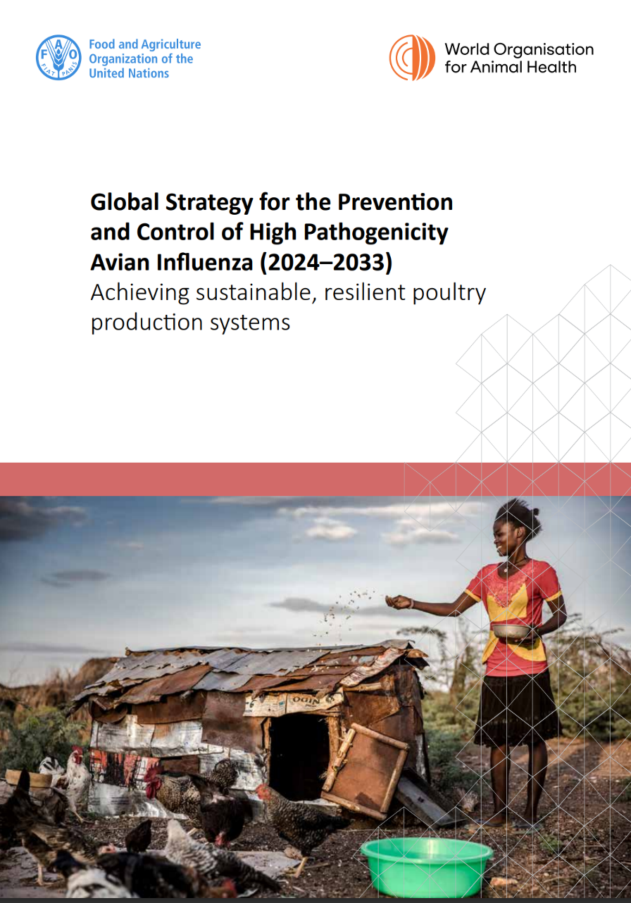
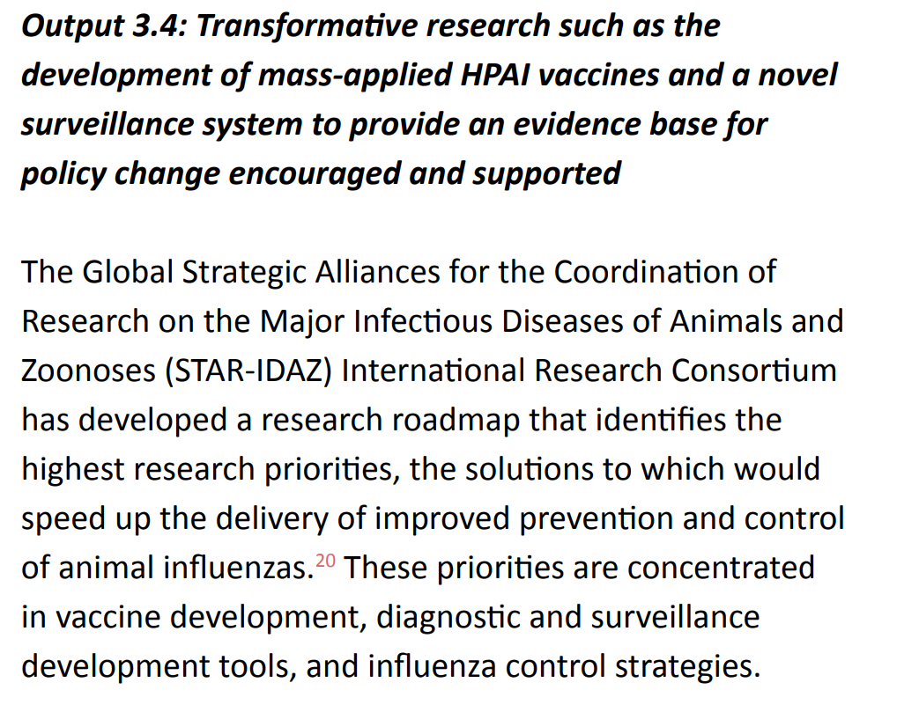
Influenza
SCAN ME

Slide 17






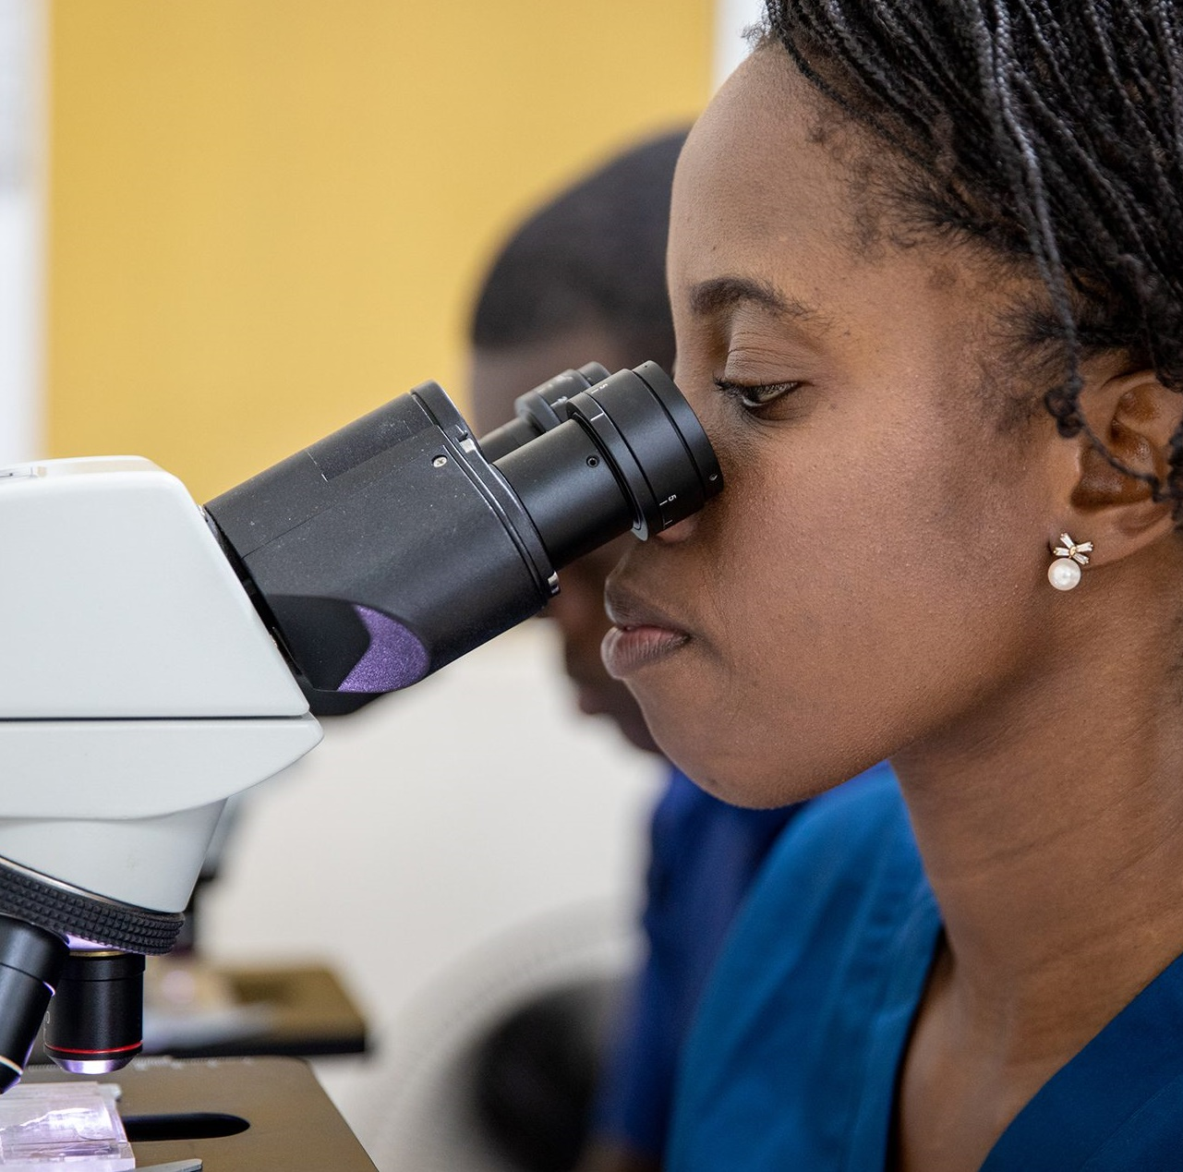






To be presented to Executive Committee in June 2025
Priority Topics Survey
Influenza
African Swine Fever
Bovine Tuberculosis
Vaccinology (tools and technology)
Emerging Issues
One Health
Aquaculture
Porcine Reproductive and Respiratory Syndrome
Vector Borne Disease
Coronaviruses
Mastitis
Foot and Mouth Disease
Brucellosis
Epidemiology
Diagnostics (tools and technology)
Helminths, inc. Anthelmintic Resistance
Porcine Respiratory Disease Complex
Animal Genetics
More to come…
AMR and ATA
Mycoplasmas
Questionnaire circled in 2011 to define Priority Topics, additional Topics added on ad-hoc basis
Survey circulated in February 2025 considering:
Organisational focus (species and disease/cross-cutting issues)
Top ten priorities for AHW in their country
Ranking current Priority topics in terms of importance
New topics for inclusion, current topics to be removed

Slide 18



Thank you for your attention
For more information on STAR-IDAZ IRC, how to become an IRC partner or join the regional networks:
www.star-idaz.net
www.linkedin.com/company/star-idaz-irc/
Twitter.com/StarIdaz
Contact STAR-IDAZ IRC Secretariat (SIRCAH):
Madeline Newman (Madeline.Newman@defra.gov.uk)
Johannes Charlier (j.charlier-external@animalhealtheurope.eu)
Gareth Dicks (g.dicks@cabi.org)
Georgina Grell (g.grell@cabi.org)
Valeria Mariano (v.mariano@woah.org)
Latifa Elhachimi (latifa@kreavet.com)
Katie Gordon (katie.gordon@defra.gov.uk)

