Slide 1
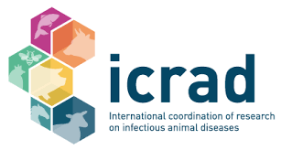
The ICRAD ERA-Net:
Achievements, Outputs & Outcomes

Slide 2
Final Showcase meeting in Paris
55 attendees including ECRs, funders and stakeholders
Agenda:
  Summary of ICRAD Achievements
  Presentations from ICRAD projects: Plants4Nemavax and POC4AIV
  Presentations from ICRAD projects with industrial partners: NanoZoo and NucNanoFish
  Sessions on the future of animal health R&D from CWG, EUPAHW
  Presentation on Horizon Scanning from FAO
  Evaluation on ICRAD from EC and ICRAD coordinators
  Speed talk and posters from 22 ECRs

Slide 3
ICRAD Call 1
Title: Improving animal health and welfare, addressing key epidemic and (re)-emerging threats (e.g., African Swine Fever, Animal Influenza), and developing novel detection and intervention strategies
Launch Date: January 2020
Projects Funded: 19 collaborative research projects
Countries Involved: Partners from 20 different countries
Funding: €20 million in national contributions and top-up from the European Commission
Analysis: Monitoring & Evaluation (M&E) team requests investigators complete a survey covering call processes and project outputs (some responses summarised here, further analysis to follow)

Slide 4
ICRAD Call 1 Outputs Summary
Research Area 1: Improved understanding of epidemic and emerging infectious animal diseases
Bruce-GenoProt
ASFVInt
RODENTGATE
FluNuance
TCWDE
PREVENTER
  Research Area 2: Generic technology platforms for producing novel and/or improved vaccines
  NucNanoFish
  Plants4Nemavax
  NEOVACC
  Research Area 3: High-throughput, rapid, accurate and easy to use in-field detection technologies
  CAE-RAPID
  TechPEPCon
  Biosens4PrecisionMastitis
MUSECoV
FMDV_PersIstOmics
ASF-RASH
BM-FARM
PIGIE
ConVErgence
IFNASF

Slide 5
Without ICRAD…
If your project was not funded by ICRAD would you have undertaken it?
94% of projects said that participation in the current project led to new/ further project ideas/ collaborations/ new applications.
Examples include:
Applications to the first EUPAHW Call
Joint applications to other calls
Ideas for future funding applications based on results from this collaborative research

Slide 6
Impacts on the Animal Health Landscape
94% said their project will or has improved animal health and welfare, by…
Contributing to Better Detection/Prevention
Reducing Transmission
Improving Understanding of Pathogens
Improving Biosecurity on Farms
Contributing to Vaccine Development

Slide 7
Impacts on the Public Health Landscape
72% said their project will have a positive impact on public health, by
Research Evaluating Risks to Humans
Enhancing Disease Control Strategies
Reducing AMR
Improved Surveillance Lowering Risk of Zoonotic Infections

Slide 8
Impacts on the Animal Health Landscape
78% said their project will lead to an increased preparedness and ability to respond to emerging threats, by
Improved Resources for Surveillance
Technology Applicable to Other Infectious Diseases
Knowledgeable Consortia Established to Work Together in Outbreaks
Improved and Faster Responses Through Increased Knowledge and Improved Diagnostics
Research Contributing to Vaccine Development

Slide 9
Reported Reasons for Applying to ICRAD Call 1
Notes:
Q14

Slide 10
ICRAD Call 2 Mid-term Reports
Title: One Health Approach to Zoonoses Research and Innovation
Launch Date: October 2021 (projects approx. half way)
Projects Funded: 10 international collaborative research projects
Funding: €12.5 million in national contributions
Participants: 66 partners from 20 different countries (incl. Argentina)
Involvement: Universities, public research organisations, and industry
Analysis: Most projects have completed mid-term reports, some results summarised here
Notes:
6 out of 10 projects have submitted reports

Slide 11
ICRAD Call 2 Outputs Summary
Diagnostic and Vaccine Development
  NanoZoo: Protein nanoparticle vaccine platform for rapid response against zoonotic viruses in poultry and swine.
  POC4AIV: Rapid point-of-care system for screening avian influenza virus in wildlife birds and poultry.
  imdiTBap: Improving the diagnosis of tuberculosis in domestic ruminants through new antigens and test platforms.
Understanding Host-Pathogen Interactions
  AdapTB: Defining molecular determinants of mycobacterial adaptation and host-pathogen interaction to inform bovine tuberculosis control.
  LEPTIMMUNHOST: Comparative host and species-specific immune responses of macrophages infected with zoonotic Leptospira interrogans.
Addressing Specific Diseases
  EPICVIR: Emerging porcine influenza and coronaviruses.
  Sclce: Classical scrapie in Iceland, a model for prion diseases worldwide.
  FLU-SWITCH: Identification of factors driving the emergence and spread of avian influenza viruses with zoonotic potential.
  ScResGoats: Classical scrapie in genetically resistant goats: questioning current concepts and policies.
  Q-Net-Assess: Improved molecular surveillance and assessment of host adaptation and virulence of Coxiella burnetii in Europe.

Slide 12
Call 2 – Midterm outcomes
Scientific and Innovation products:
  Current total 5, including 2 protocols
Number of staff and students specifically hired for the project:
 | Senior Scientist | Postdoc | PhD | MSc | Undergrad | Technician | Project Consultants | Fellowship | Other
Total | 3 | 7 | 6 | 2 | 1 | 1 | 3 | 1 | 1
Notes:
Data from 6 out of 10 projects
Products info from midterms:
Next sheep generations carrying scrapie-protective PRNP variants, no/reduced culling of sheep in scrapie affected flocks (effecting on a population of about 500,000 sheep)
Design of LAMP primers, new updated AIV primers, timescale for commercial use 2+years
fluorescence detection of amplification - fPOC prototype and cartridge design, timescale for commercial use 3+years, preexisting patent
Gelification of reagents – step by step protocol – commercial use 1+ year
New external control primers and RNA template – primers and step-by-step protocol – commercial use 1+year

Slide 13
ICRAD Call 3
Title: Increase understanding and preparedness for the effects of climate change and the spread of anthelmintic resistance on animal health and the livestock industry
Launch: April 2023
Projects Funded: 4 projects focused on anthelmintic resistance
Funding: €5.5 million in national contributions

Slide 14
Is ICRAD on-track to achieve its goals?
Supporting Cross-Cutting Research: To enhance public health, animal health, and welfare.
Connecting Research Partners: To maximise resources and share risks, costs, and skills.
Enhancing Preparedness: To respond effectively to emerging and endemic livestock threats.
Developing Improved Vaccines and Diagnostics: To better detect and control infectious diseases.
Reducing Antibiotic and Antiparasitic Resistance: To combat resistance and improve treatment strategies.

Slide 15
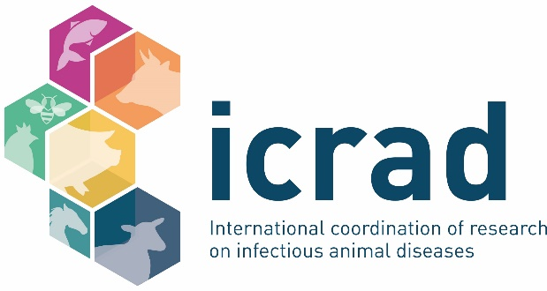

Thank you for listening…
Thom Erritt – thomas.erritt@defra.gov.uk

