Slide 1
Third Stakeholder Committee Meeting of the EUPAHW
Nathalie Vanderheijden, coordinator UGent
12 May 2025
Online, Teams meeting

Slide 2
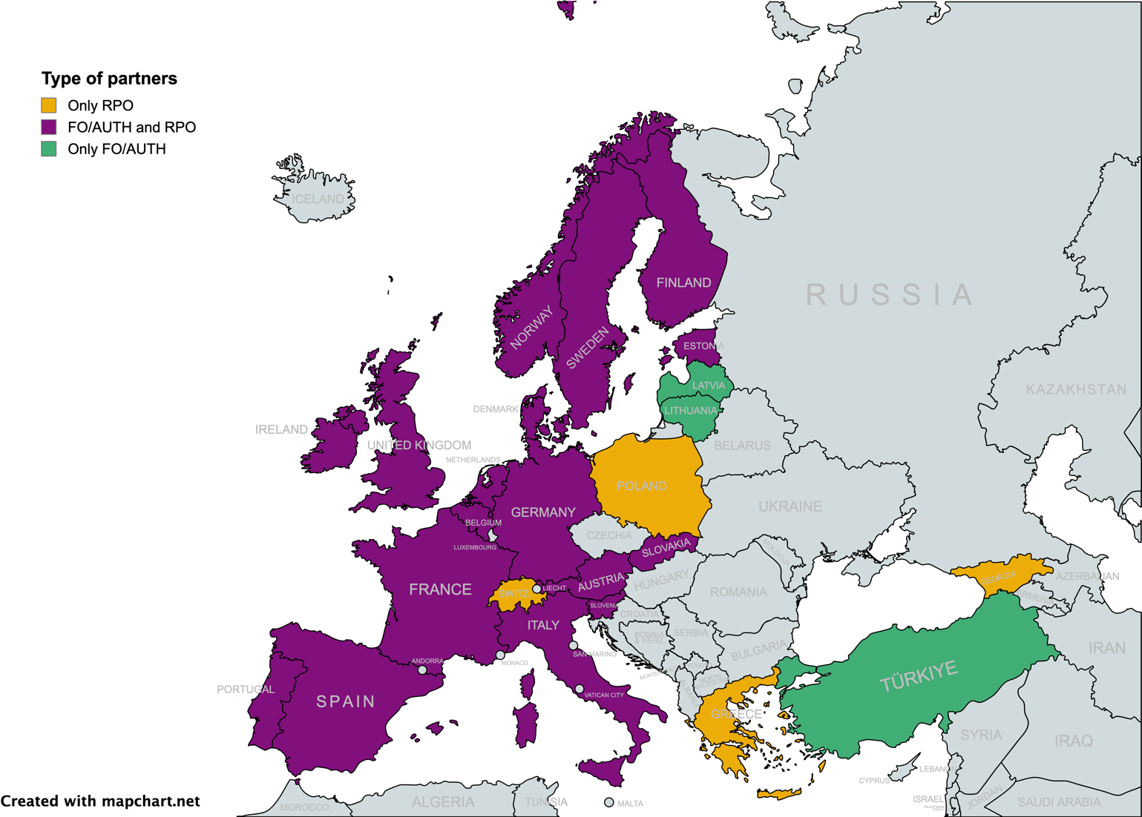



Who? European Partnership on Animal Health & Welfare
90 partners, >1000 researchers
56 Research Performing Organizations (RPO)
30 Funding Organizations (FO)
EFSA, EMA, Ministries
From 19 EU and 5 non-EU countries
Launched in January 2024, duration 7(+3) years
50% Co-funded Partnership
Expected total budget: 360 MEUR
Coordinated by
*
*
*
Project 101136346 – EUPAHW - HORIZON-CL6-2023-FARM2FORK-01
SCAN QR-code TO LEARN MORE

Slide 3

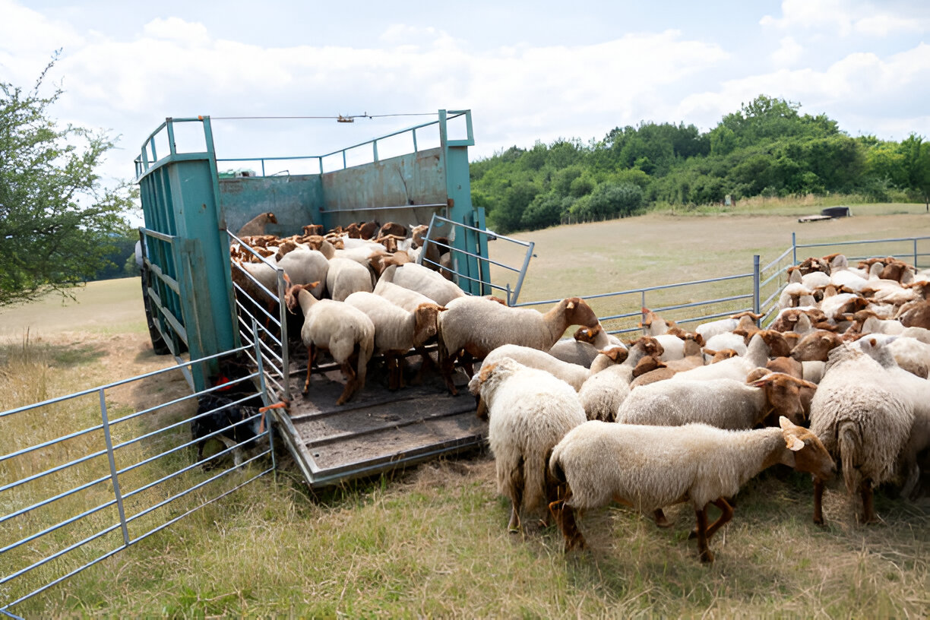



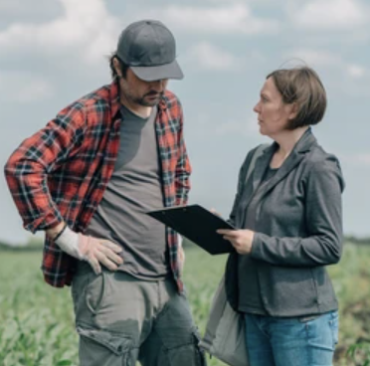

2
WHAT WE DO:
Our
Priority Areas
Surveillance/Monitoring System and Risk Assessment
Procedures, methodologies and tools to analyse AH&W
Management on farm, during transport, at slaughter and a sea
Treatments and Vaccines
Socio-economic area
SCAN TO LEARN MORE

Slide 4

The EUP AH&W SRIA
Describes 51 actions in 9 Operational Objectives
OO1. Design and harmonize surveillance and monitoring systems
OO2. Adapt risk assessment and alert communication to the new needs
OO3. Procedures and tools for disease surveillance
OO4. Procedures and tools for welfare monitoring
OO5. Fight against animal infectious diseases on farm and during transport
OO6. Advance animal welfare on farm, during transport, at end of life
OO7. New interventions & treatments against specific priority diseases
OO8. To develop new vaccines or improve existing vaccines
OO9. An integrated approach on AH&W including socio-economic aspects
These will be transposed in either:
Specific actions for the internal programme (integrative and research projects) (WP3).
Specific actions for external research calls (WP4).

Slide 5
What? Main activities of the EUPAHW
Internal programme (integrative & research activities) performed by member-RPO who bring 52% in-kind contribution
→ internal projects only partially (48%) EU-funded.
External research calls performed mostly by non-member RPO and industry and funded by national/regional funders who bring cash: financial support to third parties (FSTP)
external projects 100% funded; EU contribution for funders to increase funding

Slide 6


Next EC Framework Programme FP10
Initial GA
HE WP2023-2024
Extension GA
HE WP2025 (2026)
Deadline 16 September 2025
2024 2025 2026 2027 2030 2033
GAP
External call 1
Output indicators
Q2 2024
Q4 2030
7 years (3-year projects)
External call 2
First External Call
8 May-8 July 2024
External call 3
Projects start
Q4 2025
External call 4
SRIA
SRIA
SRIA
Internal Programme round 1 (17 projects)
5 years (3-year projects)
Q1 2024
Q4 2028
Internal Programme round 2
Internal Programme round 3
The EUP AH&W should cover a period of 10 years, with the first 7 years foreseen for the initial Grant Agreement (2024-2030)

Slide 7
External Research Calls

Slide 8
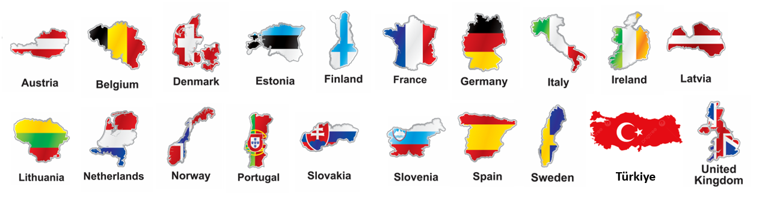
EUPAHW First External Call-2024 «Supporting the Future of Animal Health and Welfare»
including 30 Funders from 20 countries
Total budget: 24 Mio€ (FO) +6 Mio€ (EU)
Topic 1: Novel Technologies for Prevention, Detection, Assessment, and Management of Animal Health and Welfare
Topic 2: Fundamental Research for Animal Health and Welfare
Topic 3: Animal Health and Welfare and Society
Notes:
Launched this year (2024), the innovative Partnership is anticipated to invest €360 million over seven years to boost research and facilitate cooperation between all actors.

Slide 9

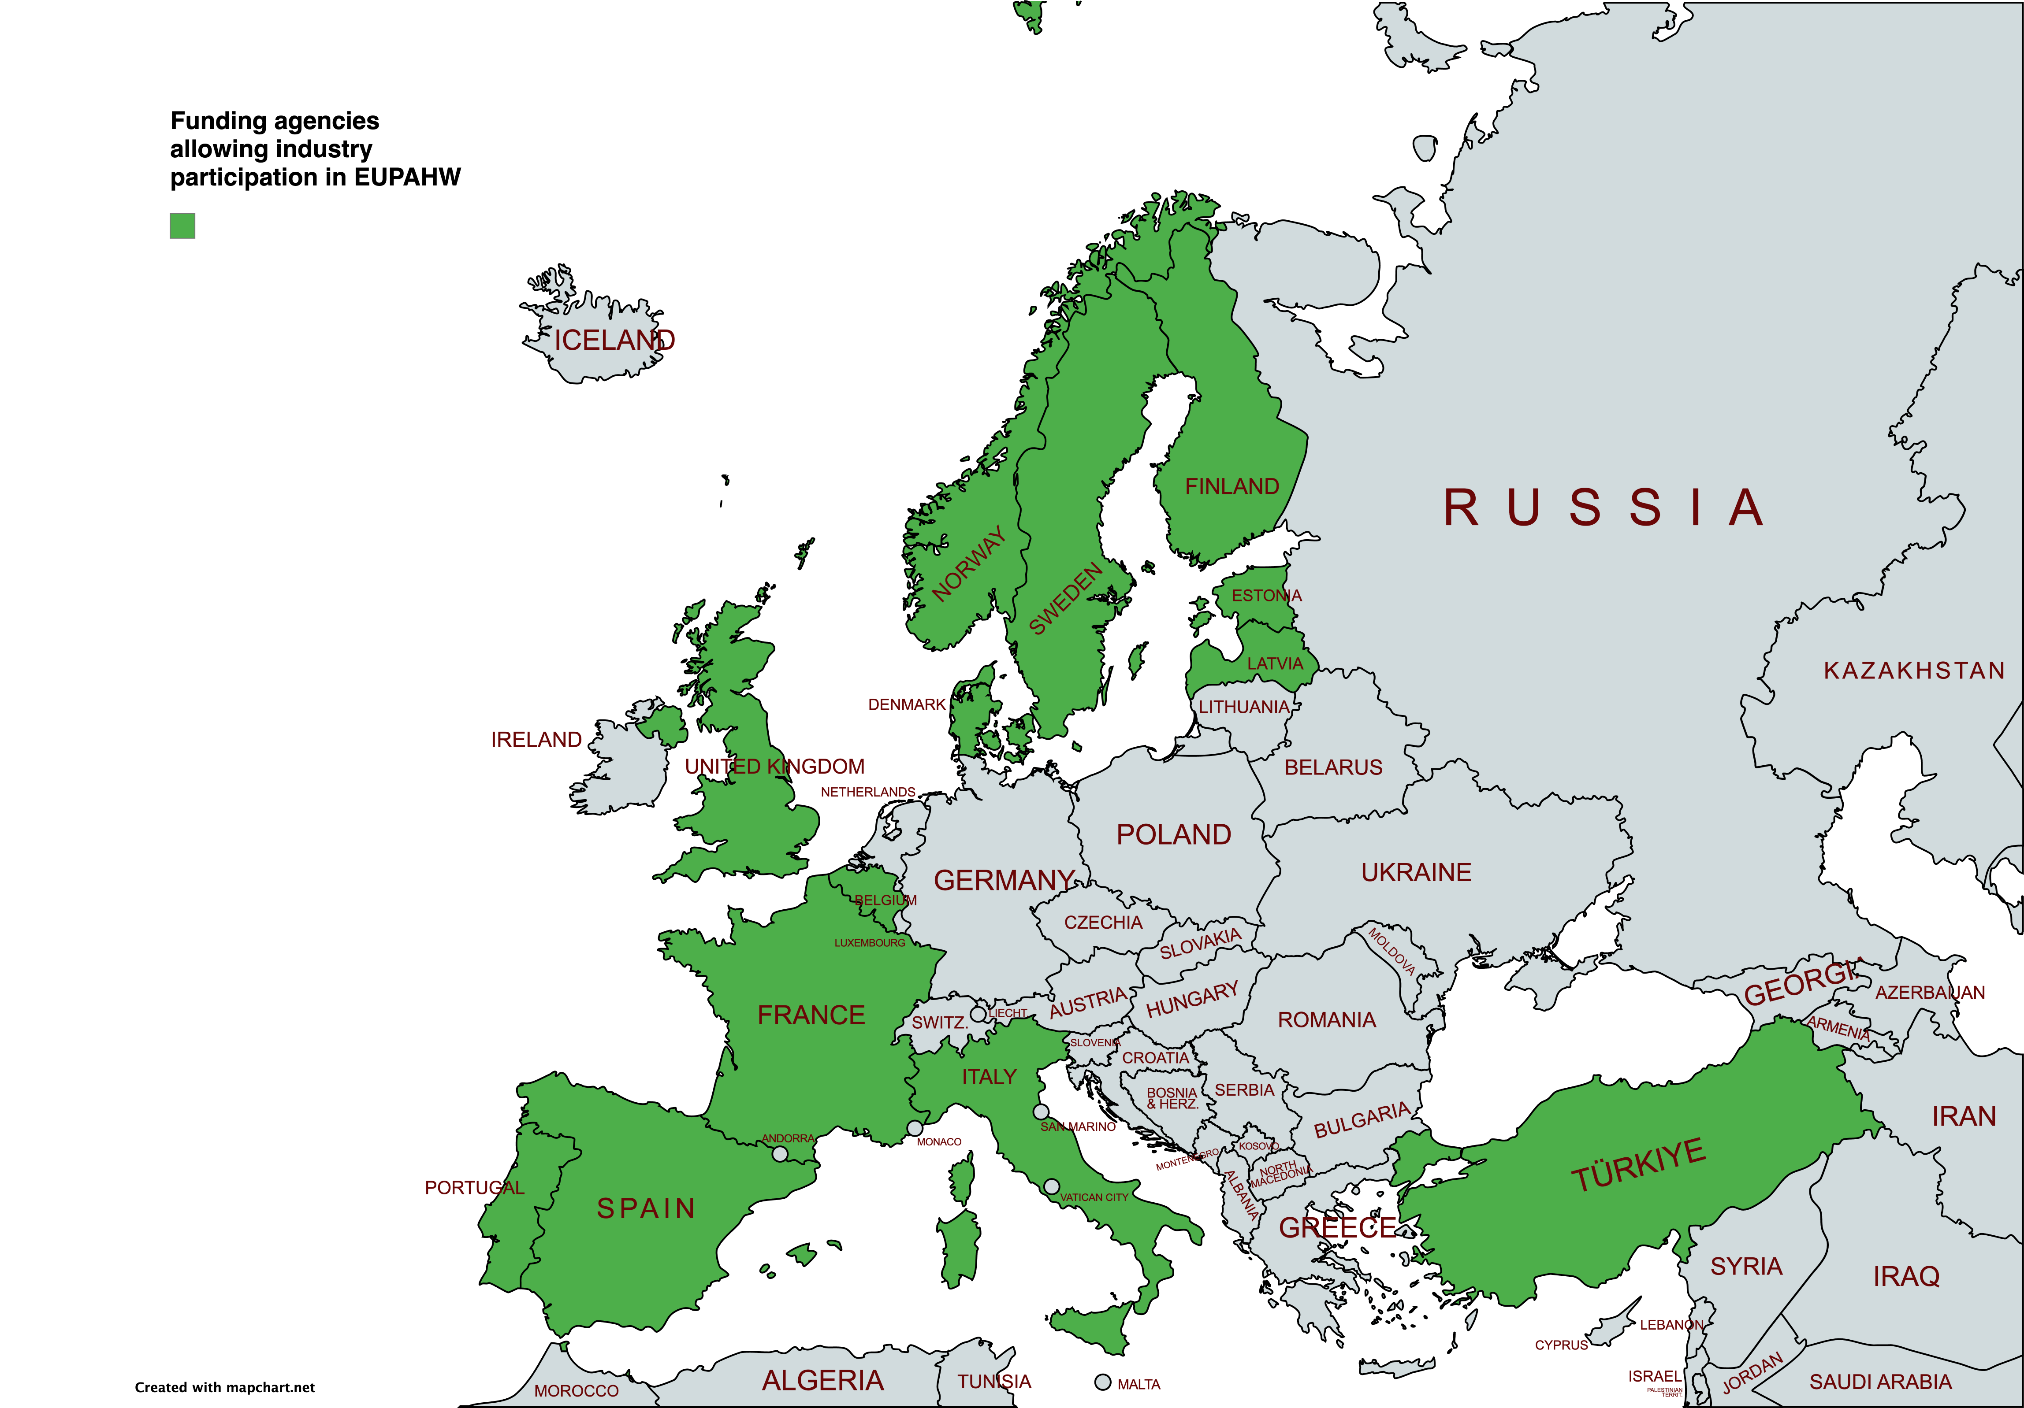
15 Funding Agencies financing also industry in external call 1
ANR (France) : 2,000,000 €
CDTI (Spain) : 500,000 €
DEFRA (UK) : 2,000,000 €
ETAg (Estonia) : 300,000 €
FCT (Portugal) : 500,000 €
FIO (Belgium) : 800,000 €
FORMAS (Sweden) : 2,000,000 €
FPS Health (Belgium)* : 400,000 €
IFD (Denmark) : 1,000,000 €
LZP (Latvia) : 500,000 €
MEM (Estonia) : 100,000 €
MMM (Finland)** : 400,000 €
MUR (Italy) : 2,000,000 €
RCN (Norway) : 1,480,000 €
TUBITAK (Turkey) : 600,000 €
*only university spin-off or a private laboratory
**max. 50% for companies. Product development supporting individual companies not supported
Conditions apply (multi-partners, topics, …): see call announcement on the EUPAHW website

Slide 10








Timeline
STEP 1
Feedback on
Evaluation
Feedback on
Selection decision
November 2024
Call Launch
8 May 2024
Pre-proposal
Submission
8 July 2024
Peer-review
Evaluation
Pre-proposal selection Meeting
STEP 2
Full-proposal
Submission
November 2024
-
4 February 2025
Peer-review
Evaluation
Full proposal selection Meeting
Feedback on
Selection decision
June 2025
Project start
July- December 2025
Contract negotiations
Feedback on
Evaluation

Slide 11
External Calls and timelines (subject to approval of our WP2025 amendment)
1st call: finalised
2024-2025
2nd call
Early 2026
3rd call
2027
4th call
2028

Slide 12
Task 2.1
(1) Identification of which SRIA Actions will be proposed for next programme
(2) Consultation on this identification
List of proposed Actions
(3) Identification of the type of action.
* RPOs: which actions can they perform?
* FOs: which actions should be for external research.
* AUT: indicate requirements for e.g. risk assessment
Proposal on categorisation of Actions
(4) Approval of Proposal
Approved list of categorised Actions + Comments
Updated SRIA
Advice
GenA
Decision
Decision
GovB
Advice
EB
GovB
(17) Update the EUP SRIA
SAB
Internal
Advice
SHC
Task 2.3
(9) RPOs indicate interest and their own contribution
(8) Invitation to Collaborate
Task 3.2
Provisionally approved projects
(7) Approval of provisional projects and budgets
(6) Estimation of budget
(5) Transposing Actions into internal projects
Task 3.1
(10) Preparing proposals
SAB
EB
Advice
External
Advice
SHC
AUT
SAB
SHC
Decision
Task 3.3
Decision
Decision
Task 4.2
EB
GovB
(11) Ensuring SAB and SHC suggestions are addressed. Submission to EB
Task 1.1
(12) EB finalises set of proposals
Set of proposals
(13) Approval of new Work Programme
Task 1.1
(14) Task 4.2 - 4.4 external call process
(15) Execution and progress monitoring of internal activities
Task 3.4
New Work Programme
Task 4.5
Execution and progress monitoring of external activities
(16) Monitor the effect of the actions defined in the EUP SRIA
Task 2.2
Ongoing

Slide 13
Thank you for your attention!
Nathalie.Vanderheijden@ugent.be - coordinator
Veronique.Rebholtz@ugent.be - deputy coordinator
EUPAHW@ugent.be

