Slide 1
SCAR FOOD SYSTEMS SWG AHW CWG meeting
Maroun El Moujaber, CIHEAM-Bari
Date: 15th May 2025, Online

Slide 2
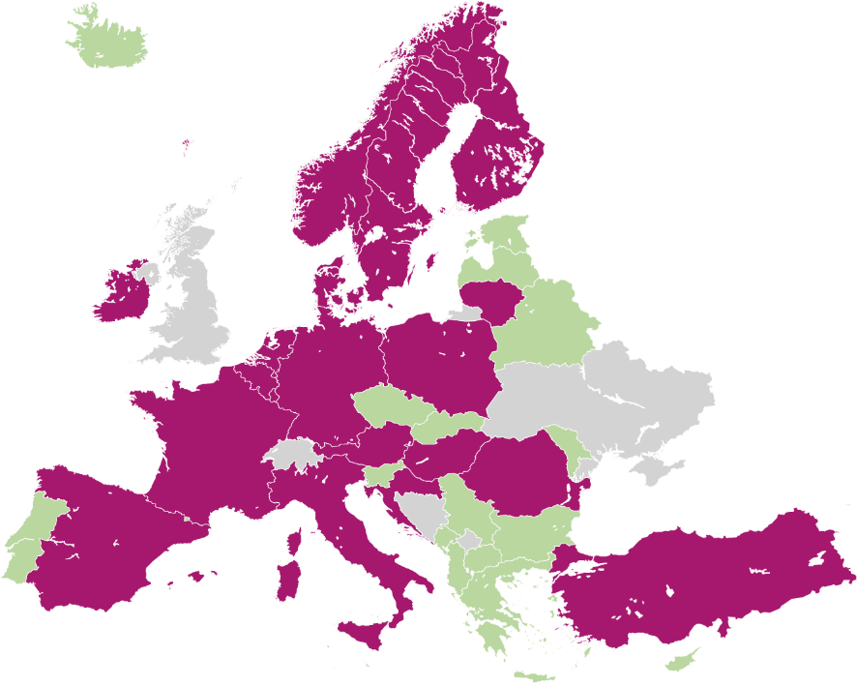

SCAR FOOD SYSTEMS SWG
Chair:
Monique Axelos, FR
Co-chair:
Niels Halberg, DK
Members:
22 countries + EC and key advisors
SCAR FS member SCAR member Not a member
Overview members SCAR FS – update March 2022

Slide 3
SCAR FOOD SYSTEMS SWG Members
Members:
22 EU Members States and Associated Countries : AT, BE, BG, CZ, DE, DK, ES, FI, FR, HR, HU, IE, IT, IS, LT, NL, NO, PL, RO, SE, TR, UK
Observers/ Advisers: FACCE- JPI, JPI OCEANS, HDHL, CIHEAM-Bari, Copa-Cogeca
EU Commission: DG RTD et DG AGRI
Chairs:
Chair: Monique Axelos, Scientific Director Food and Bioeconomy, INRAE, FR
Co-chair: Niels Halberg, Senior researcher, Aarhus University, DK
Co-chair: Minna Huttunen, Ministry of Agriculture and Forestry, FI (to be back in Sept. 2025)
Management : Anastasiya Terzieva, INRAE, FR

Slide 4


Mission of the SCAR FS SWG
Provide strategic advice, orientation, and support to the EU R&I policy framework FOOD2030, and to Cluster 6 of Horizon Europe.
Contribute to the successful implementation of the Farm to Fork strategy, as well as the UN SDGs and the COP 21 commitments.
Promote the development and shaping of the food system R&I policy implementation at EC level.

Slide 5
Main rationale
Provide strategic intelligence and orientation by integrating and analysing the different regional, national, European and international initiatives in place and priorities of the Member States.
Support Member States in accelerating their policies for FS transition
Contribute to reach the ambitions of the EU Green Deal, Farm to Fork strategy, and EU’s climate goals.
Support the finalisation of the EC “Legislative Framework for Sustainable Food Systems” and contribute to its implementation.

Slide 6
SCAR FOOD SYSTEMS SWG 2016-2026
SCAR FS SWG Mandates:
1st mandate: December 2016 –December 2019
2nd mandate: December 2019 – December 2022
2nd mandate extension: December 2022 – December 2023 – to support the SFS partnership development and finalise ongoing actions
3rd mandate: December 2023 –December 2026

Slide 7

What was achieved during the 2nd mandate- DELIVERABLES
Sustainable Food Systems Partnership
Narrative
Template
Strategic Research and Innovation Agenda (SRIA)
Action 1. Food Systems of the Future:
Workshop report: Prioritising future R&I breakthroughs for food systems via scenarios
Portfolio Analysis of R&I EU projects “Food Systems R&I Needs and Gaps Report”
Action 3: Translate Science into Policy
Workshop report: Translate Science into Policy-Best Practices and Challenges
Portfolio Analysis: Translate Science into policy – 12 project fiches
Policy brief: Improving the Framework of Science to Policy Translations to Strengthen the FS Transition
Survey Report : SCAR FS SWG Action 3 “Translating Science into Policy”
Action 6. Digitalisation and Artificial Intelligence
Workshop report: Assessing Digitalisation in Food Systems
Portfolio analysis: Digitalisation and Artificial Intelligence for sustainable Food Systems
Methodology to assess the level of digitalisation of the food systems in different EU countries – Lithuanian example

Slide 8
What are the top priorities for the 3rd mandate?
3 Priority actions (3rd mandate Dec. 2023-Dec 2026):
Accelerating and Monitoring Food Systems Transition
Food Systems Resilience
International dimension of food systems
Collaboration with and contribution to:
FutureFoodS Partnership (contribution to WP5 FS Observatory and WP6 Knowledge hub and Living Labs)
FOODpathS CSA
Foresight 6th exercise
Collaboration with other relevent SCAR SWGs

Slide 9
3 Priority actions (Déc. 2023 -Déc. 2026)
Priority actions:
Action | Task Leader
Accelerating and monitoring Food Systems Transition | Silvia Scaramuzzi, University of Florence, IT Michael Sulzner, Federal Ministry of Social Affairs, Health, Care and Consumer Protection, AT
Food System Resilience | Vera Musch, Ministry of Agriculture, Nature and Food Quality, NL
International Dimension of Food Systems | Maroun El Moujabber, CIHEAM-Bari

Slide 10
Accelerating and Monitoring FS transition: Aims and scope
This action aims at fostering the acceleration of Food Systems (FS) transition through the identification, support and synergic integration of:
fundamental drivers, leverage points and barriers for change, at political, social, economic, and technical level
innovative governance approaches
This entails the adoption of actions in R&I, public policy, and legislative frameworks where the integration of a Food Systems Approach has to be fostered. It is fundamental to remind that this is a comprehensive and holistic analytical approach.
Notes:
OBJECTIVES OF THE ACTION
The action aims at fostering the acceleration of FS transition through the identification, support and synergic integration of fundamental drivers and barriers for change, at political, social, economic, and technical level and innovative governance approaches.
This entails the adoption of actions in R&I, public policy and legislative frameworks, where the integration of a FS approach has to be fostered.

Slide 11
Accelerating and Monitoring FS transition
Planned activities:
Literature review on food system transformation drivers.
Expert workshops on governance and policy tools.
Policy recommendation documents targeting EU and national stakeholders.
Ongoing activity: - carry out a study supported by RefreSCAR
Literature review « An assessment framework for sustainable food systems transition: drivers, barriers and the role of governance”
Objective: To define a holistic conceptual model to describe the components, interactions and dynamics of FS transition.

Slide 12
FS Resilience
Aim: To understand and enhance the resilience of food systems in the face of crises such as pandemics, climate change, or market shocks.
Ongoing activity: carry out a strudy on Resilience, supported by RefreSCAR
To give insight in current definitions and concept of resilience (e.g. link with sustainability, Food sovereignty, ..)
To document and gather real life resilience case studies from member states
To synthesize existing knowledge on cascading risks and systemic shocks and stressors in the EU food systems
To provide suggestions how resilience can be incorporated in an EU food security strategy
Expected results:
1st results in June
Final report in September

Slide 13
International dimension of Food Systems
Aim:
Food Systems are heavily interconnected regionally and globally through supply chains and international trade: R&I cannot be implemented within a European perspective only.
Identification of needs and barriers to integrate food systems at European and International level;
Identification of synergies with international partnerships (i.e., PRIMA, EU-AU High Level Policy Dialogue on FNSSA) and promotion of their development;
Promote at international level the activities of the SCAR FS SWG.
Ongoing activity: preparation of the portfolio analysis request, which will be supported by RefreSCAR

Slide 14

Portfolio Analysis - Objective
The Objective of the portfolio analysis is to identify the impacts and linkages of food systems with trade. In this regard, it is necessary to take into account three main pillars: policies, funding and projects on the following proposed themes.
Policies
Funding
Projects
Local and International Trade
Large-Scale Retail Distribution
Food Procurement
Food Environment
Agricultural markets and trade
Food Security (availability, access, utilization, stability)
Food Sovereignty

Slide 15
Other Activities and Collaborations
:
Collaboration/ Contribution
FutureFoodS Partnership (SRIA, FS Observatory, International dimention etc.)
FOODPathS Project
Other SCAR SWGs:
SCAR ARCH et SCAR BIOECONOMY – joint workshop (2024)
SCAR ARCH -collaboration within action on International of FS (2025-2026)
Animal Health and Welfare CWG
SCAR Foresight
SCAR Bioeconomy

Slide 16


Policy Brief by SCAR ARCH, Food Systems and Bioeconomy
Outcome of the joint workshop held in January 2024
To accelerate the transformation to sustainable food systems at European and global scales, R&I needs were identified and how R&I should be undertaken was discussed, according to four areas of intervention by international experts invited to the workshop in January 2024
Four areas of R&I intervention to accelerate the transformation of food systems
1. Enhancing performance measurement and monitoring of food systems
2. Strengthening resilience and food and nutrition security
3. Promoting inclusiveness, equity and fairness
4. Improving governance and harmonizing policies
https://scar-europe.org/images/FOOD/Deliverables/SCAR_Research-innovation-priorities-sustainable-food-systems_Europe-globally.pdf

Slide 17
Why Should the Food Systems SWG and Animal Health & Welfare Collaborate?
Both groups share goals for sustainable and resilient FS (ensuring Food and nutrition security, promoting environmental sustainability etc.)
To complement expertise on AHW: FS SWG bring system thinking, governance, and R&I policy alignment and AHW CWG can bring technical knowledge on disease management, welfare standards, and veterinary research.
To align with the resilience focus of our activities and respond on emerging challenges
To share data and policy analysis
To develop joint activities: workshop and policy recommendations

Slide 18
NEXT SCAR FS SWG MEETINGS
12 June, Warsaw, PL, from 9:00 to 15:00
ordinary SCAR FS SWG meeting to discuss ongoing activities and the results of Resilience study
Side event to the High Level Polish Conference R&I for Fostering Cooperation
1st and 2nd October, The Hague, NL
Joint event with FOODPathS project
Dedicated session on Food Systems SWG

Slide 19
Task Leader: Maroun El Moujaber, CIHEAM-Bari
Chair: Monique Axelos, INRAE, FR
Co-chair: Niels Halberg, Aarhus University, DK
https://scar-europe.org/

